Slide 1
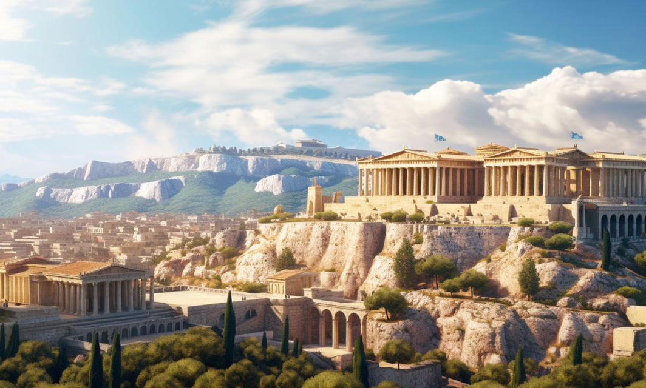
Ancient greeCE

Slide 2
reading
We will continue to cover the discrete reading skills through a class book and topic specific texts:
Vocabulary
Infer
Predict
Explain
Retrieve
Summarise
Class read: Who Let The Gods Out by Maz Evans.
ancient
gods
Greek
Vocabulary:
infer
justify
Greece
history
temple

Slide 3
WRITING
The text types we are learning about this half term are:
Playscripts – using model playscripts to set scenes with descriptive writing, read lines and follow stage directions for actions, movement or mood using brackets
Persuasive writing – using a model holiday brochure, we are going to tempt our readers to holiday in Ancient Greece for their next holiday destination.
margin
character
vocabulary:
brochure
persuade
speaker
playscript
colon
dialogue
entice
bracket

Slide 4
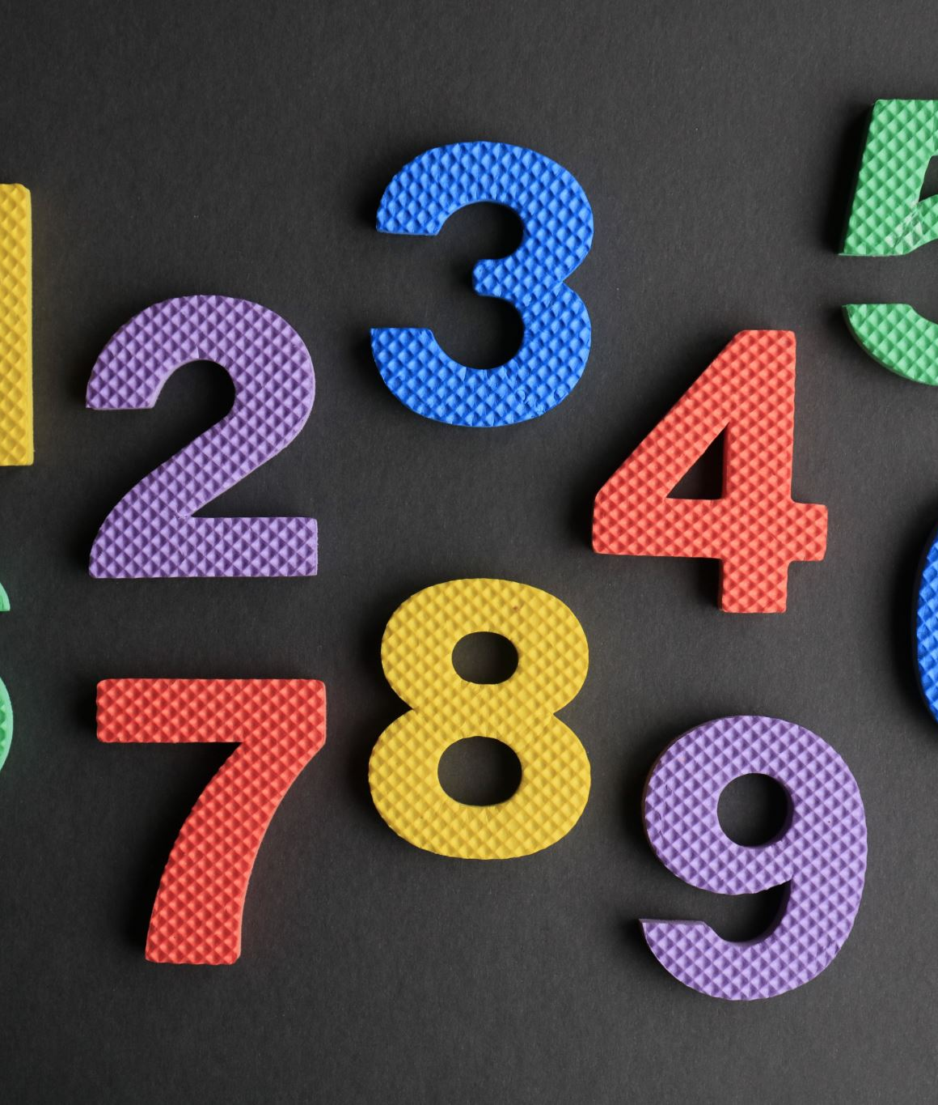
maths
We will be continuing working through our maths units, focusing on fluency skills and then developing our reasoning and problem solving.
Fractions
Decimals
mixed number
place value
Vocabulary:
part
fraction
divide
partition
whole
hundredths
decimals
tenths

Slide 5
SCIENCE
We will be learning about Electricity and cover
I can name things that run on electricity and know mains and battery
I can name the main parts of a circuit and build a working circuit
I can use standard symbols for parts of a circuit
I can explain which materials conduct electricity and which ones don’t
battery
conductor
Vocabulary:
wire
circuit
insulator
connection
cell
bulb
symbol

Slide 6
HISTORY
We will be learning about the Maya Civilisation.
I can find Greece on a world map
I can place Ancient Greece on a timeline
I can name city states in Greece.
I can name Greek gods and goddesses
I can explain some ways that Ancient Greece influences our modern lives
I can describe some styles of Greek building
Vocabulary:
Zeus
temple
columns
democracy
Olympia
culture
Athens
politics
Sparta
Mt. Olympus

Slide 7
COMPUTING
We will be learning how:
data gathered overtime can be used to answer questions.
digital devices can collect data automatically.
a data logger collects data points from sensors over time.
a computer can help us to analyse data.
to identify the data that is needed to identify a question.
to use data from sensors to answer questions.
accept
analyse
Vocabulary:
safe
gather
data
programme
Tell
sensor
data logger

Slide 8
P.s.h.e
We will be learning about keeping ourselves and others safe ONLINE in our unit ‘Digital Wellbeing’ by:
Identifying the positives and negatives of being online.
Being kind online and make the internet safer.
Knowing how to communicate safely online.
Knowing what to do when I do not feel safe online.
Knowing how to decide what is reliable and what to share online.
Knowing how technology can affect our wellbeing.
I dial 999 for emergency help.
Childline telephone is 0800 1111.
Two ways to keep safe online are to never share personal information and always tell a trusted adult when something scares me.
The difference between banter/joking and bullying is that the victim enjoys banter, bullying is upsetting and repeated.
CHOICE
substances
Vocabulary:
safety
ChildLine
emergency
risks
responsibility

Slide 9
ART or D.T.
We will be admiring art from Ancient Greece and making our own Greek vases
I can explore and talk about Greek art
I can design a Greek vase for display
I can decorate a Greek vase using different media
I can explain my choice of materials and the significance of the design elements.
Vocabulary:
sketch
collage
decorate
model
plan
design
template

Slide 10
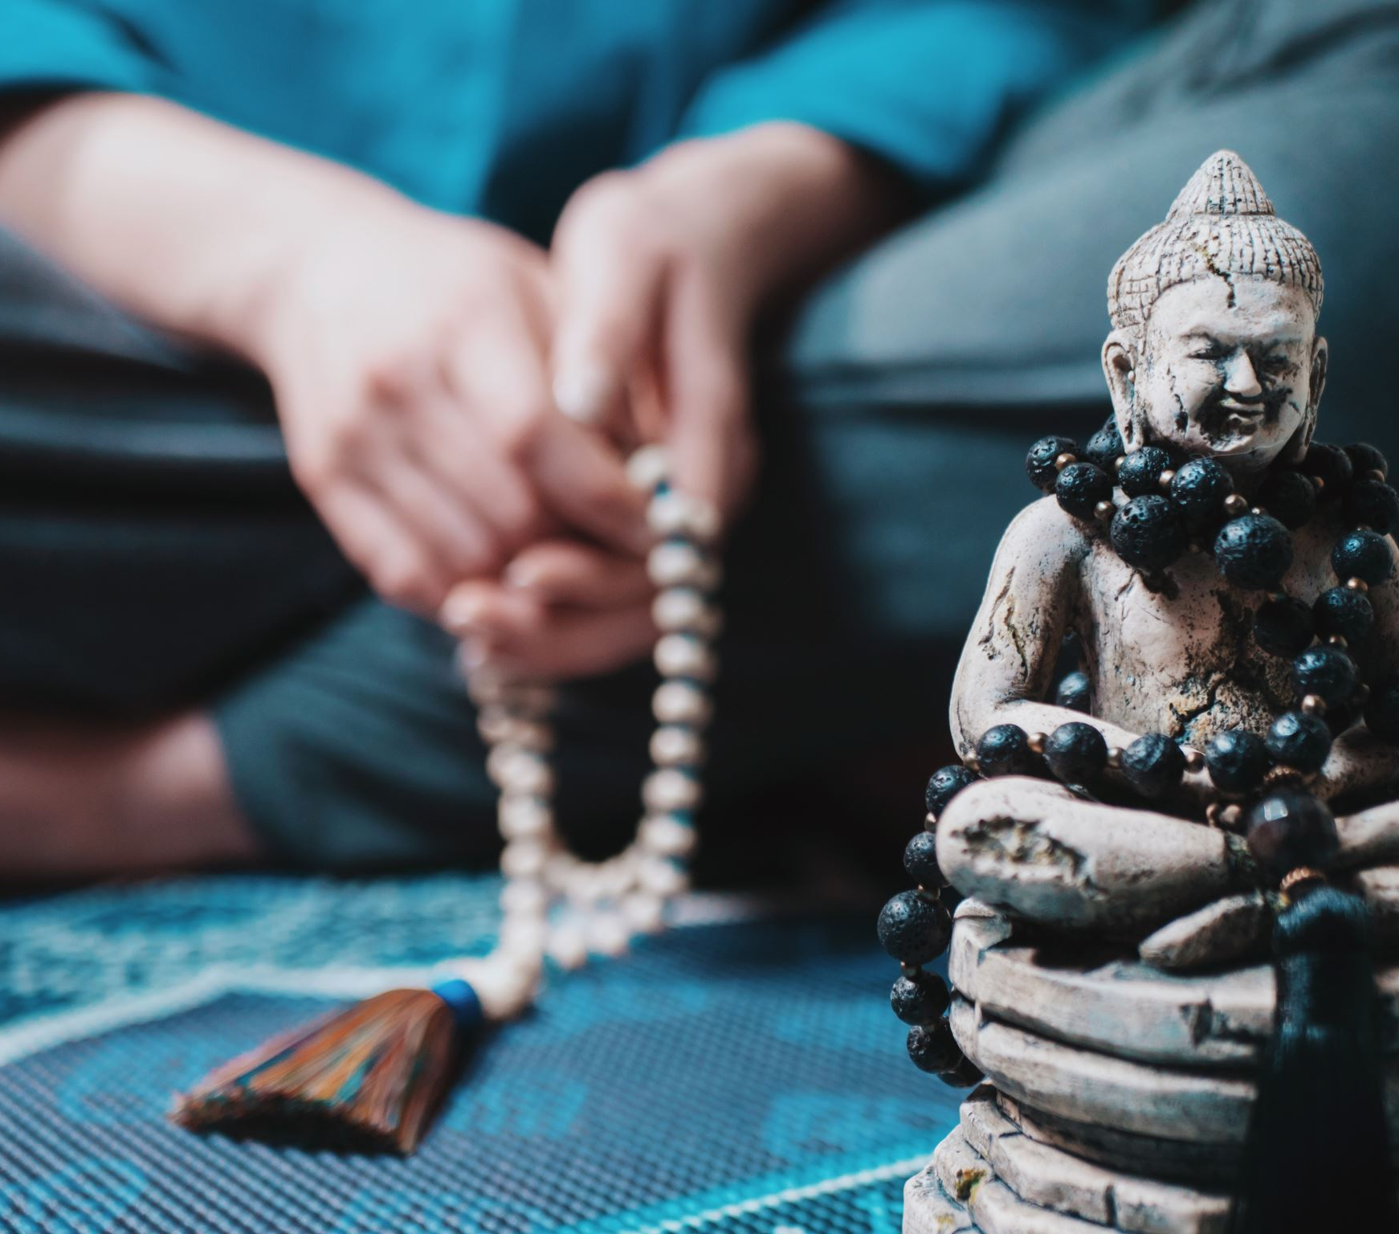
R.e.
How and why do people in Cornwall mark significant events in community life?
Why do we celebrate special times in our lives?
How do we celebrate special times in Cornwall?
What is the connection between Harvest Festivals and Cornwall?
I can explain the significance of St Piran for Cornwall.
I can identify sacred sites in Cornwall.
Vocabulary:
St Piran
sacred
Celtic
pagan

Slide 11
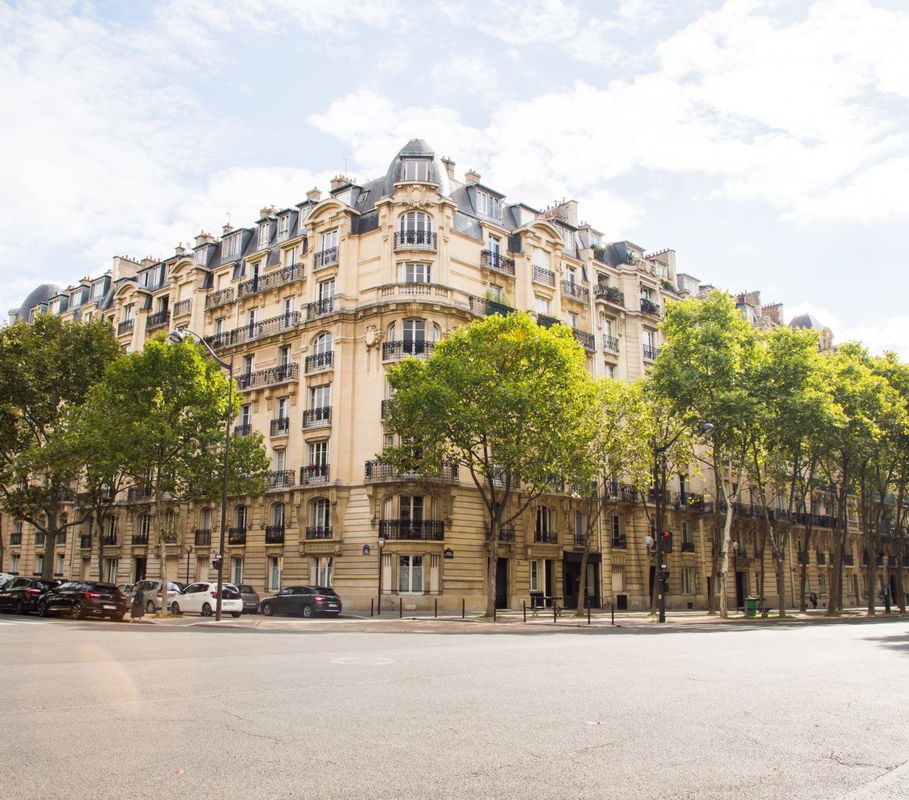
french
We will be learning verbs to describe various activities, sports and hobbies.
I can name different animals – pig, lion, bird, horse and rabbit
I can name more animals – cow, duck, monkey, mouse and sheep
I can guess animals from different descriptions.
I can describe different animals
Vocabulary:
devinez
animal
lapin
souris
cheval
oiseau
singe
lion
cochon
vache
mouton
animaux
canard

Slide 12
P.e.
We will be learning about:
Tennis
Racket skills: balance and coordination
Send and receive
Outdoor Learning
Fire safety
Shelter building
Tree identification
Team building
CAMP at BF Adventure 7/8 May
teamwork
problem solving
Vocabulary:
net
racket
opposition
aim
receive
send

Slide 13
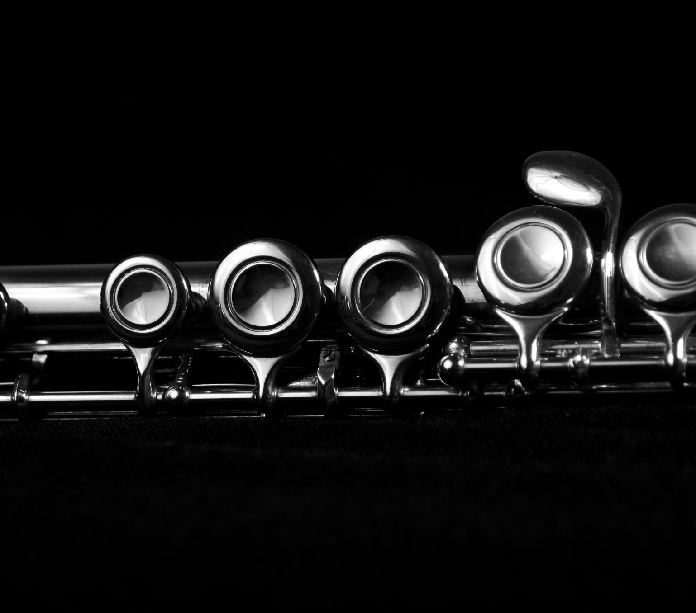
music
In our singing assemblies we will be using our voices with increasing accuracy, fluency, control and expression. We will listen with attention to detail and recall sounds with increasing aural memory. We will appreciate and understand a wide range of high-quality live and recorded music drawn from different traditions and from great composers and musicians.
The songs we will focus on will be linked to the theme of Ancient Greeks and our weekly assembly themes:
Living it up in Greece
Proud-of-our-school
One-moment-one-people/
This-little-light-of-mine/
Try-your-best
expression
record
Vocabulary:
sound
control
composer
fluency
recall
detail

Slide 14
How does music impact your daily life? What do you listen to relax or get yourself pumped ready for exercise?
Who Let The Gods Out by Maz Evans, Tales of Beedle the Bard by J.K. Rowling and some more Little People, BIG DREAMS.
Exploring how the diversity of Ancient Greece through linguistic and cultural differences, as well as ethnicity and trading movements.
We will assess children’s learning using KIRFs and quizzes.
We will be testing different materials to see whether they conduct electricity or insulate against it.
Challenge our taste buds with Level 3 homework.

