Slide 2
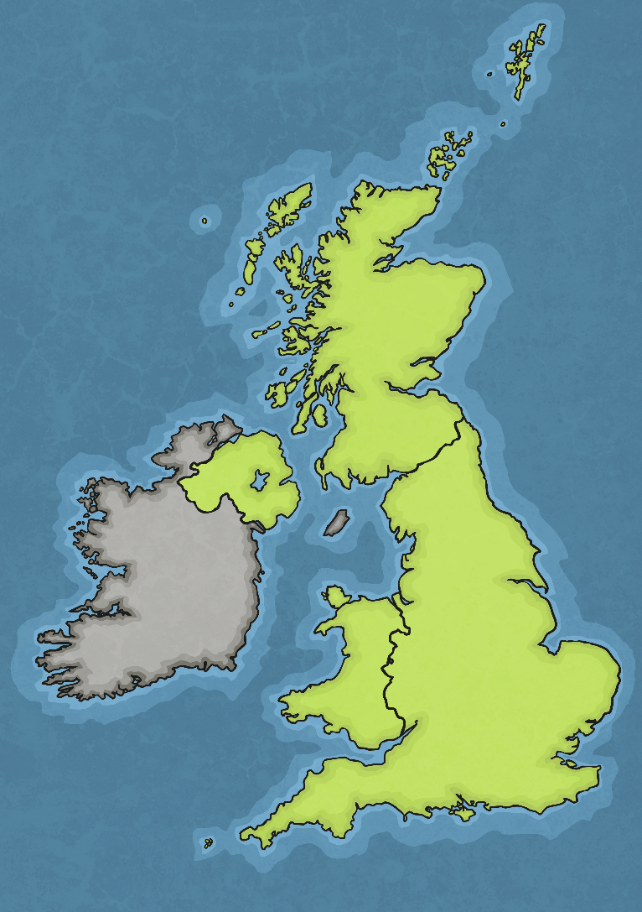
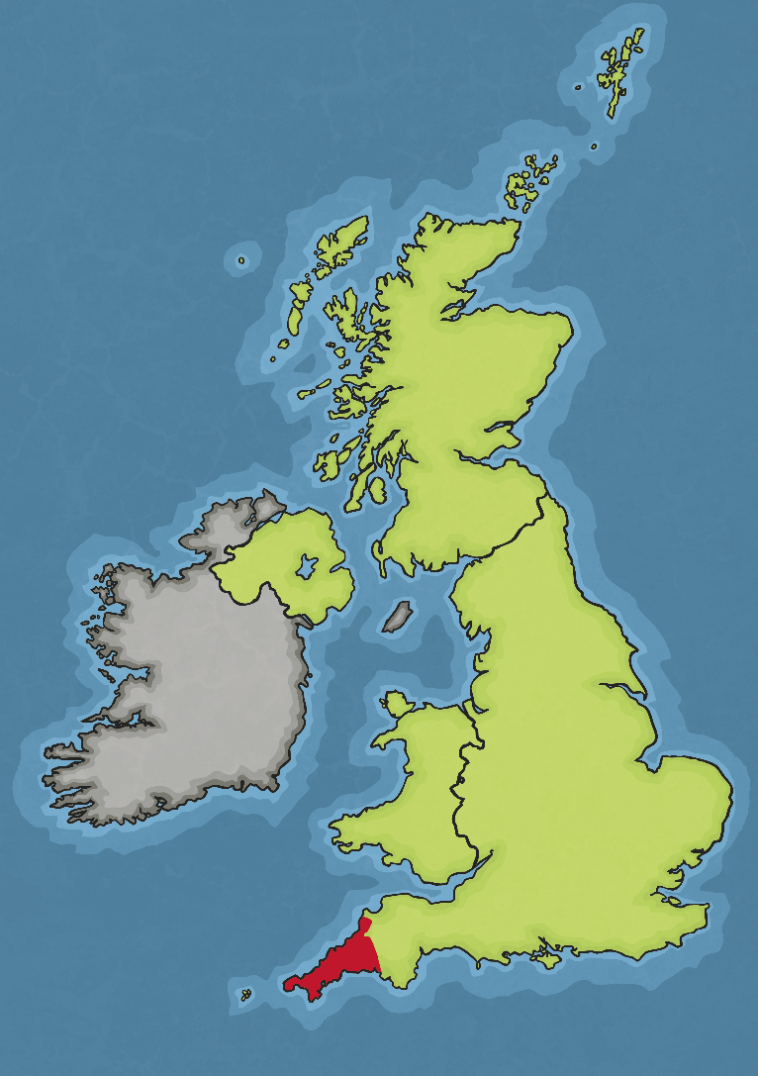
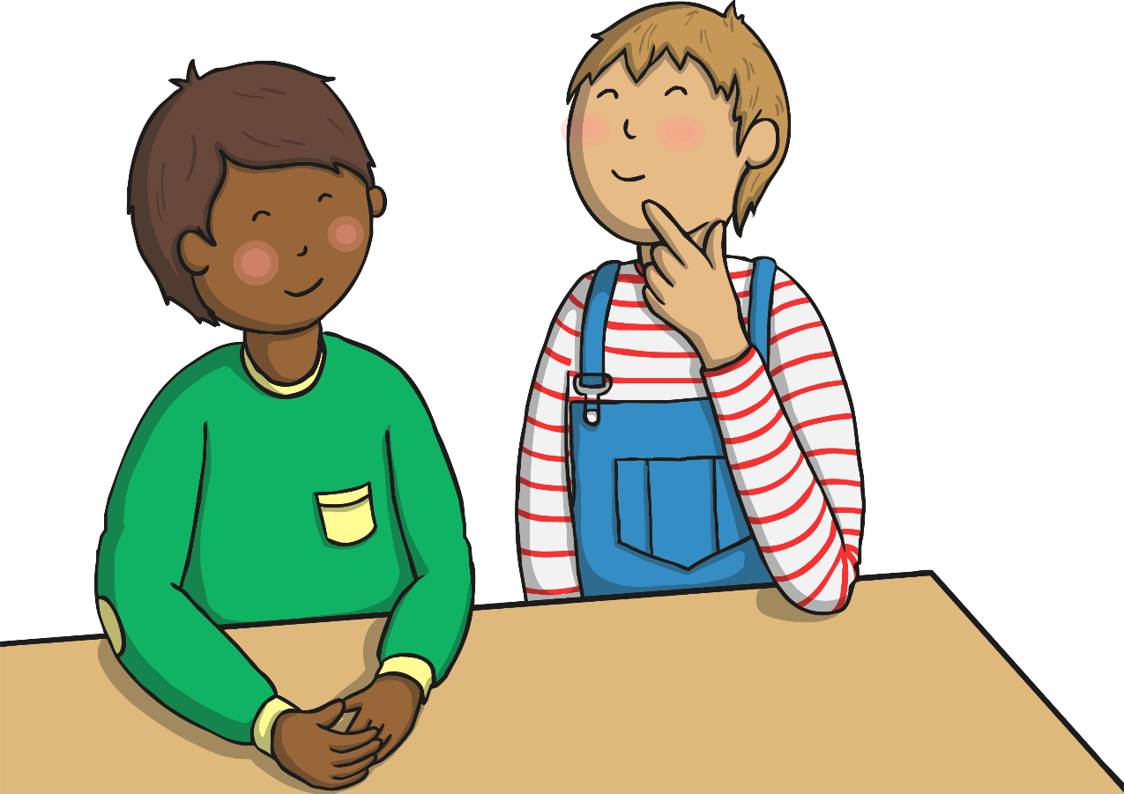
Where is Cornwall?
Talk About It
Can you see where you live on
this map?

Slide 3
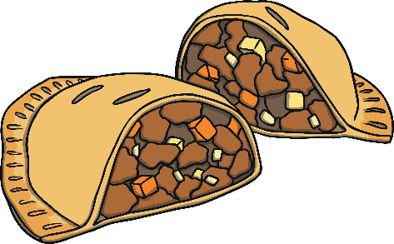
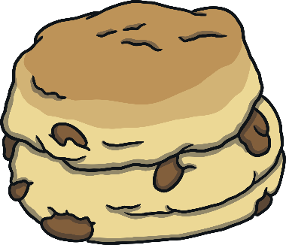
What is Cornwall Like?
Cornwall is a beautiful county and lots of people go there on holiday.
Talk About It
Where would you like to go on holiday?.
Cornwall is famous for it’s lovely beaches, pasties and cream teas.

Slide 4
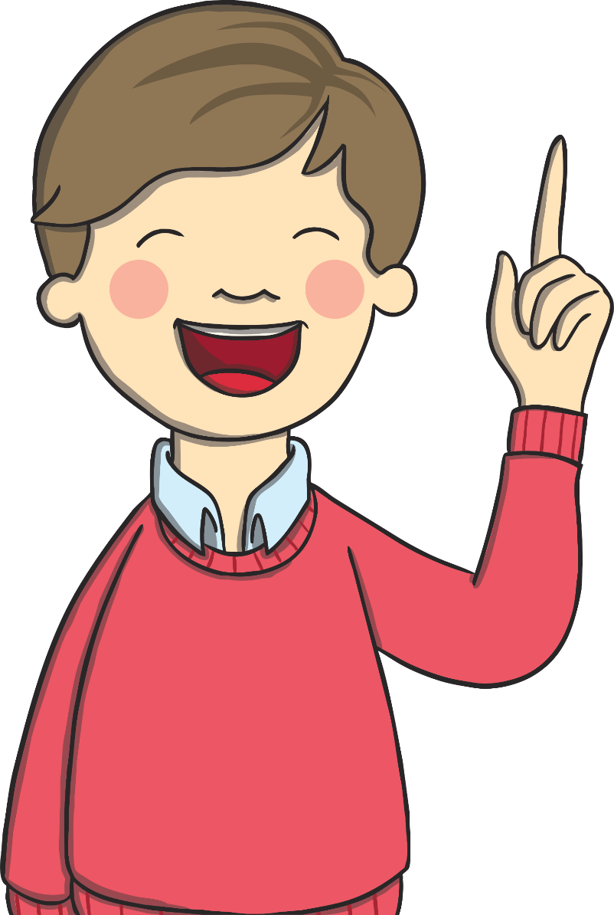
What is Cornwall Like?
Did You Know?
Both Cornwall and its neighbour Devon
are famous for scones with jam and
clotted cream. In Devon, they put the
cream on followed by the jam, in
Cornwall it’s jam then cream. Both
counties insist they are right!

Slide 5
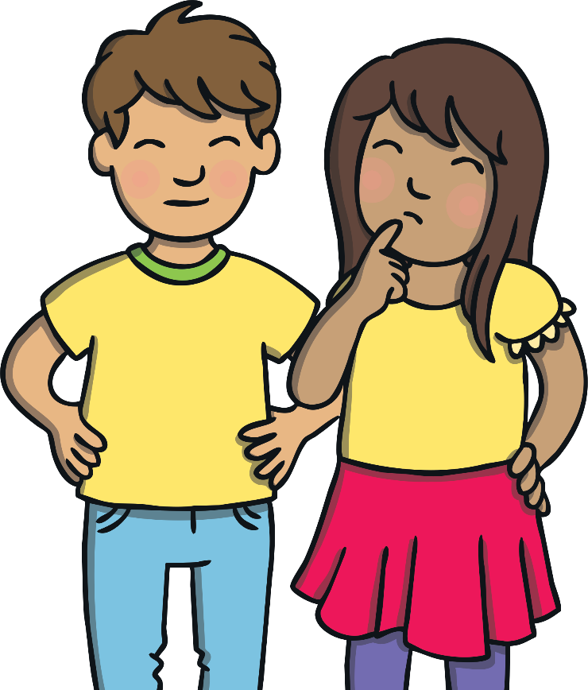
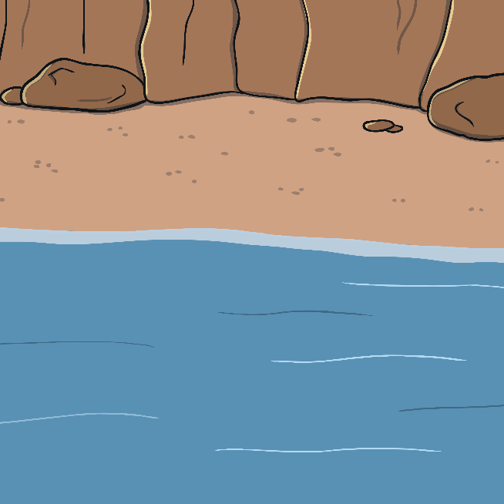
St. Piran’s Day
St. Piran’s Day is the national day of Cornwall and is celebrated each year on 5th March. Lots of places have a special day.
Talk About It
Do you know the special days of any other places?
Here are the special days of some other places:
Unity Day – Germany
Bastille Day – France
Republic Day – India
Freedom Day – South Africa
Australia Day –Australia
St David’s Day – Wales
Canada Day - Canada

Slide 6
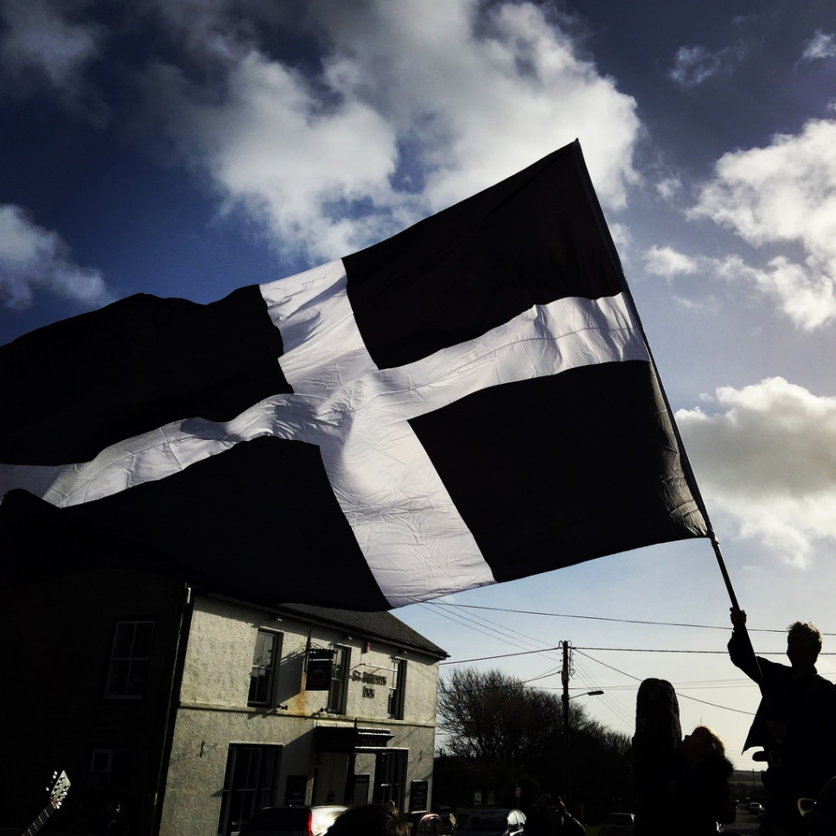
What Happens on St. Piran’s Day?
In Newquay, the weekend nearest to St. Piran’s Day has a surfing competition, barbeques, a parade and a barn dance.
You might want to spend St. Piran’s Day in Truro, where
they give away free pasties!
On the Sunday nearest to St Piran's Day, the village of Perranporth holds a play and procession. Many people there carry the Cornish flag and dress in the traditional colours of Cornwall; black, white and gold. The play tells the story of the life of Saint Piran.
Did You Know?
Truro is Cornwall’s only city.

Slide 7
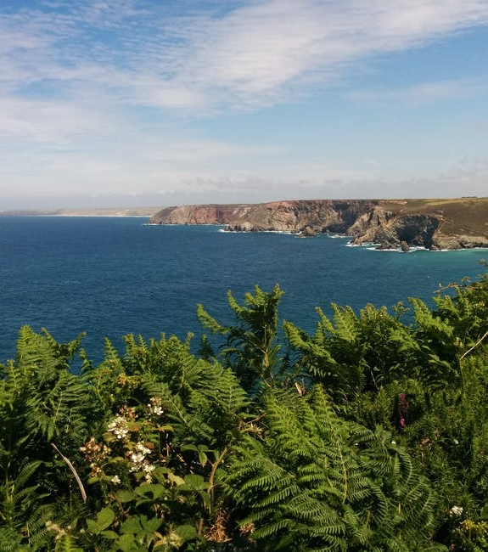
Who Was Saint Piran?
People began to be jealous of Saint Piran’s ability and he was forced to leave Ireland. Some people think he was actually tied to a large stone and thrown into the sea!
The legend is that he performed a miracle and sailed to Cornwall where he landed on a beach. This place is now called Perran Beach in his honour. The remains of a small chapel thought to be built by Saint Piran can still be seen buried in the sand.
We aren’t definitely sure who Saint Piran was. However, most people think he was a Christian leader from Ireland. The story goes that he was able to perform miracles and make sick people better.

Slide 8
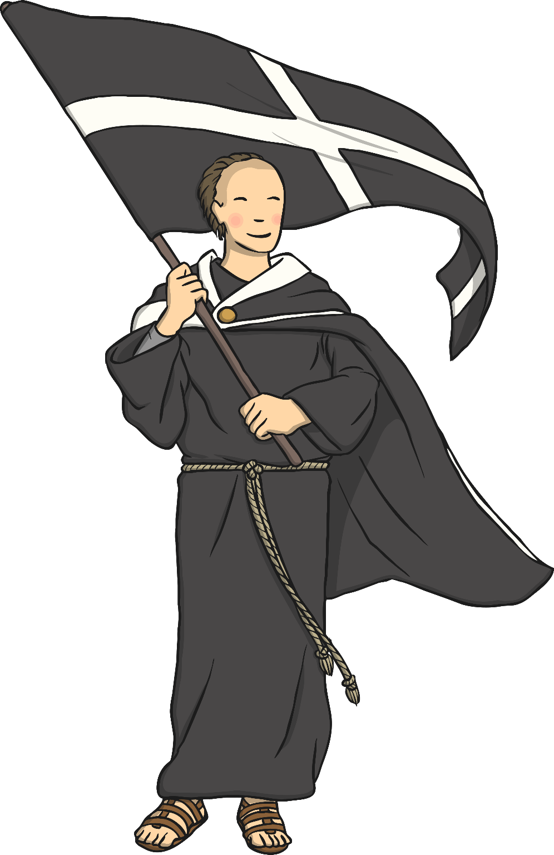
Who Was Saint Piran?
Saint Piran became very popular in Cornwall and people would travel for miles to hear him talk about God. Legend says that it was Saint Piran who discovered tin. The story goes that Saint Piran had lit a fire and suddenly a white liquid leaked from one of the black stones. This liquid was the metal tin.
Tin has been an important part of Cornwall, which is full of tin mines. For hundreds of years, many villages made their living through mining tin.
For this reason, Saint Piran is the patron saint of tin miners. A patron saint is a Christian person who lived long ago who is special to a group of people.
Did You Know?
Legend has it that Saint Piran lived until he was 200 years old!

Slide 9
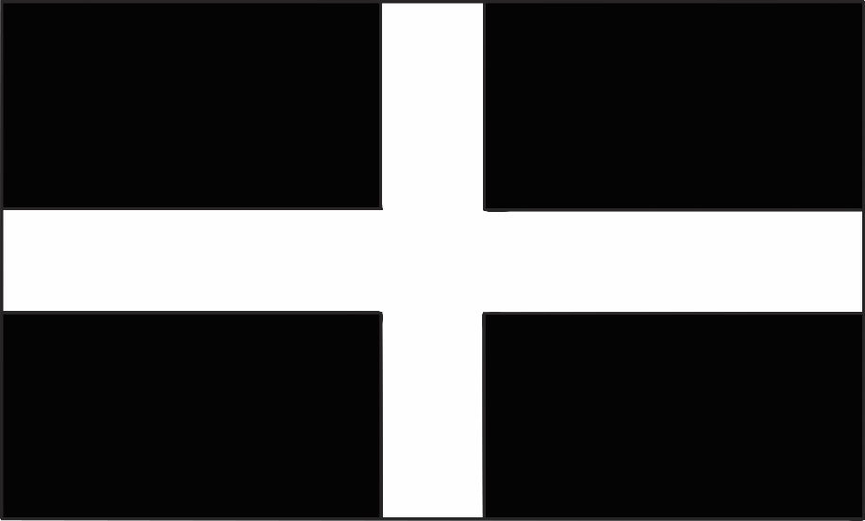
Saint Piran’s Cross?
The Cornish flag is called Saint Piran’s Cross. The black represents the black stone in the story, the white represents the metal that came out from the stone. It also represents good overcoming evil.
Does this look like any other flags you have seen?
Talk About It

