Slide 1
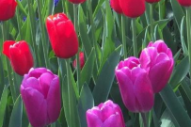
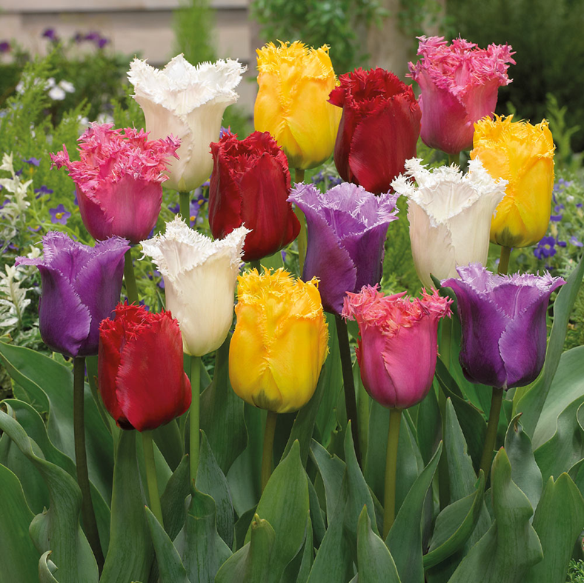
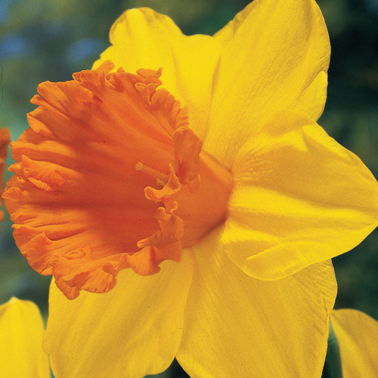
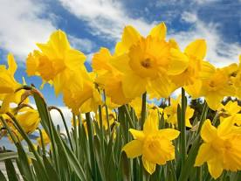
Let’s colour our daffodils today
Choose which of your daffodils from last week to colour first
Or you can draw a new daffodil following the steps on last week’s power point

Slide 2
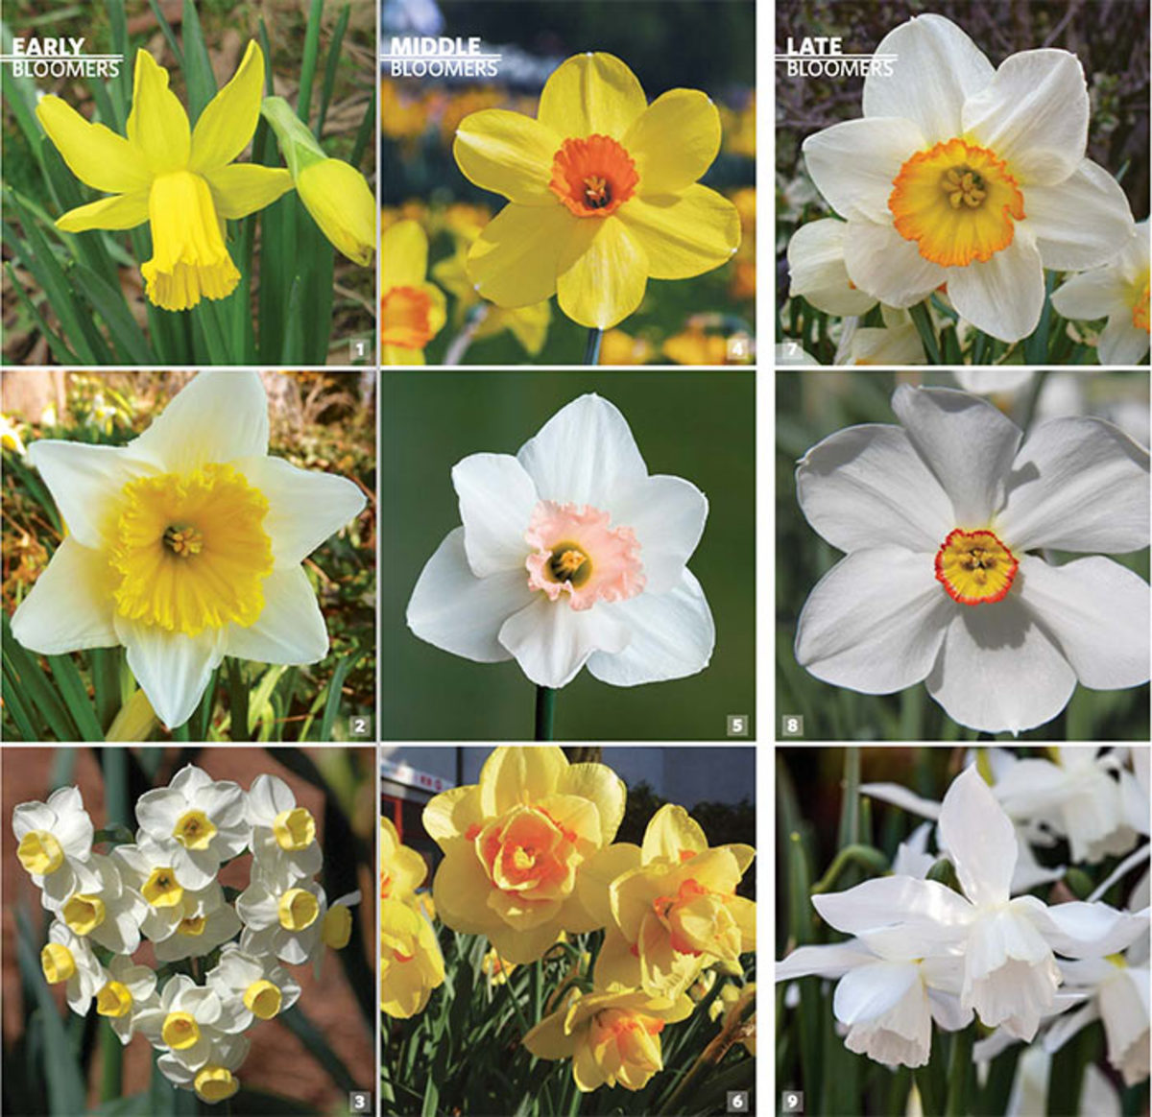
Daffodils are not just yellow!

Slide 3
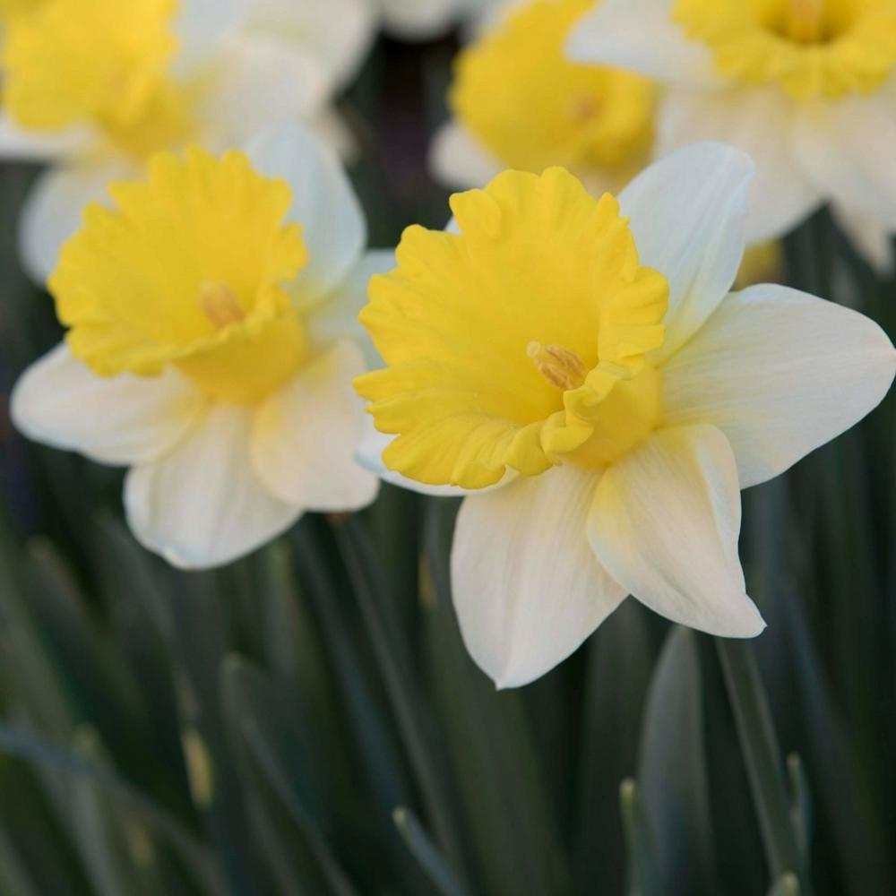
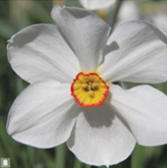
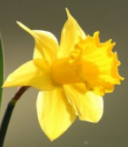
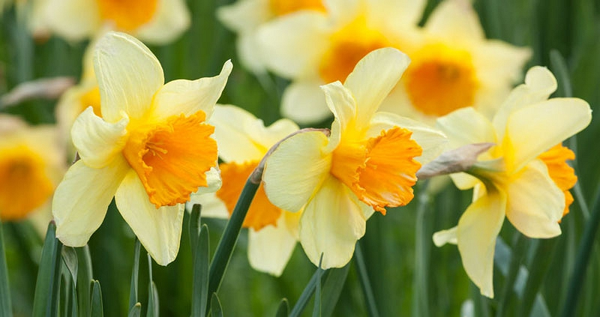
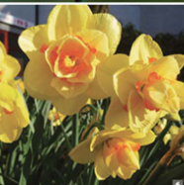
Daffodils come in all different shades of yellow, white and orange.
Some have very pale yellow petals with dark yellow trumpets and some have dark yellow petals
and orange trumpets and some daffodils are white with yellow and orange trumpets.

Slide 4
Daffodils come in all different shades of yellow and orange.
Some have very pale yellow petals with yellow trumpets and some have deep yellow petals
and orange trumpets.
Look at the palette of colour below and match the daffodils to the colours in the pallette

Slide 5
You can either choose some colours from the palette and daffodil pictures on the previous slide, or you can use your own daffodil to find the right colours to match the petals and trumpets.
Here are some colouring tips:
Making yellow darker- Press harder with your pencil for a darker effect and more gently for a paler effect.
Mix a tiny amount of with yellow to create a
more orangey yellow
Mix a little more red with yellow to create orange

Slide 6
Top tips for neat colouring
Decide wich part of the daffodil you will colour first
Practise creating the correct colour for this part of your flower first
Star by colouring carefully and softly at first. You can press harder as you get as the colour develops
Colour around the edges first, before colouring the middle of each part
Colour in the same direction and from the outside in to keep it neat
Don’t scribble
Take your time!
Please take a photo of your coloured daffodil and send it in for your Teams Assignment

