Slide 1
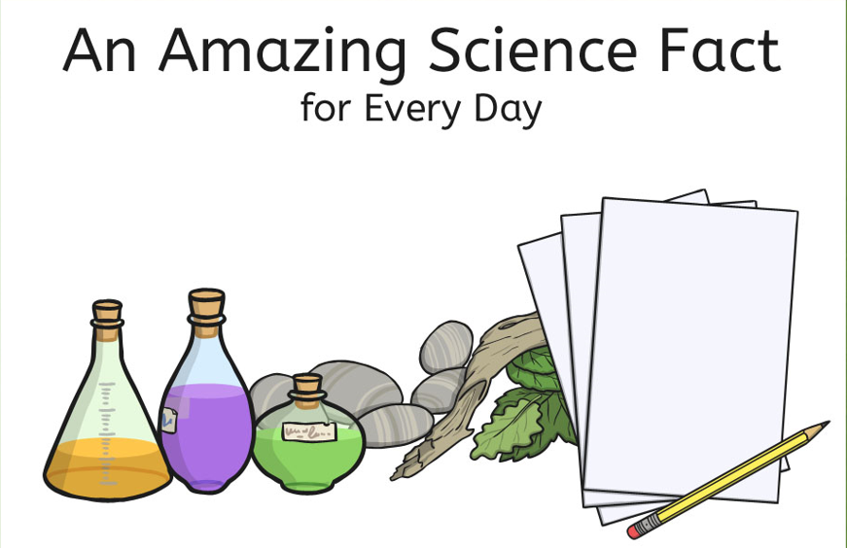

Slide 2
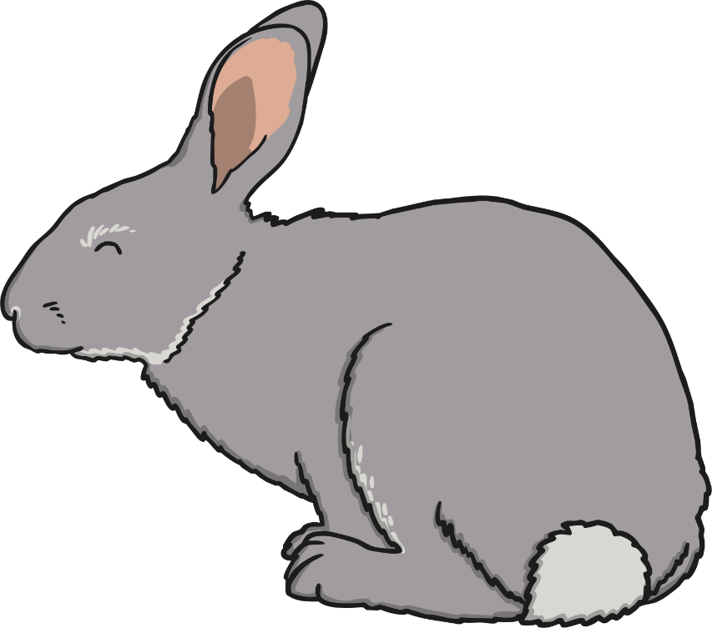
1st
Rabbits can see behind themselves without even moving their heads! Their eyes are on the sides of the head, rather than on the front, like ours. Rabbits can watch their surroundings while keeping completely still so they don't become obvious to predators.
You could investigate:
if there are any other animals that can look backwards without moving their heads;
how you can use a mirror to look behind you without moving your head;
which animals prey on rabbits, and construct a food chain to show this.

Slide 3
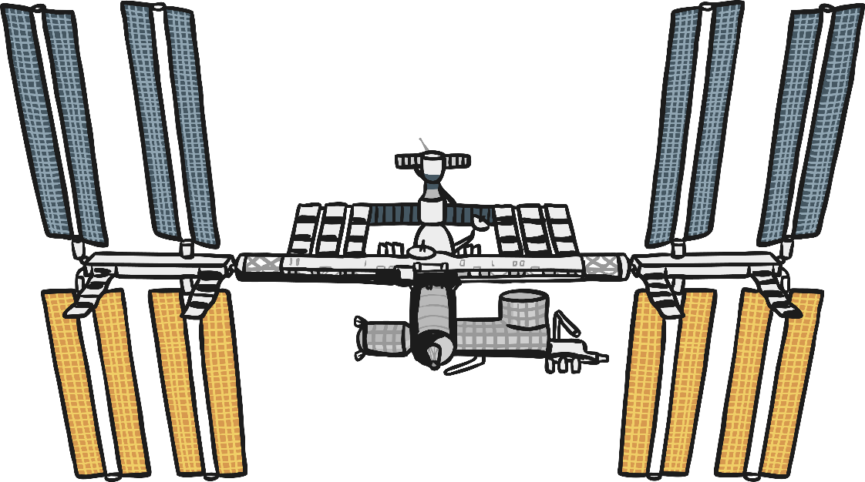
2nd
Human beings get slightly taller in space because there is no gravity pulling them down. Astronauts living on the International Space Station can grow up to 3% taller during their time there. The vertebrae of their spine expand and relax, allowing them to stand taller. However, on returning to Earth their height goes back to normal within a few months.
You could investigate:
how tall you would be in space;
other effects of living in microgravity;
how strong the force of gravity on Earth is.

Slide 4
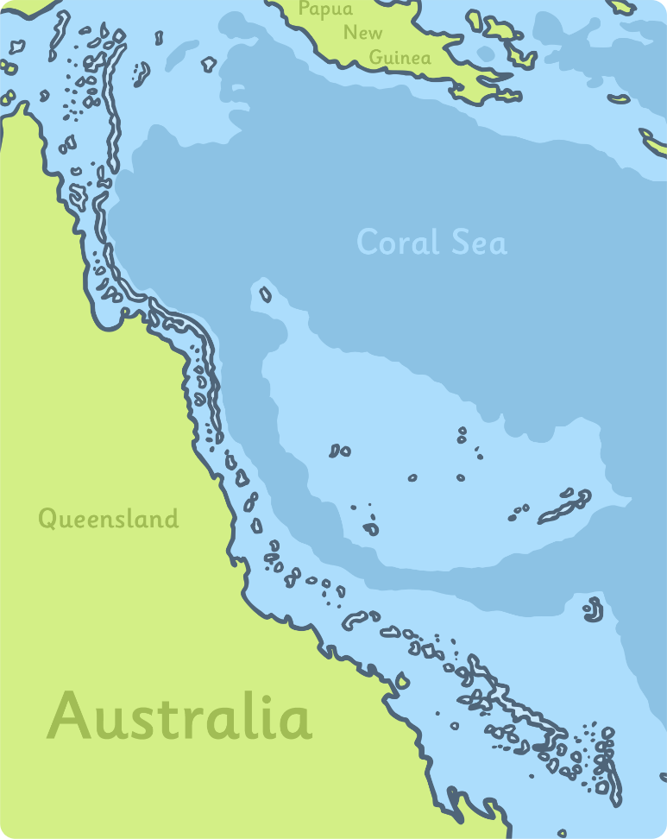
3rd
The largest living structure on Earth is the Great Barrier Reef off the coast of Australia. It is over 2,000 km long! It is made of coral, which is the exoskeletons of tiny animals called polyps. The whole reef is so large it can be seen from space!
You could investigate:
what the smallest living thing on Earth is;
how many different species live in the Great Barrier Reef;
the dangers faced by Great Barrier Reef.

Slide 5
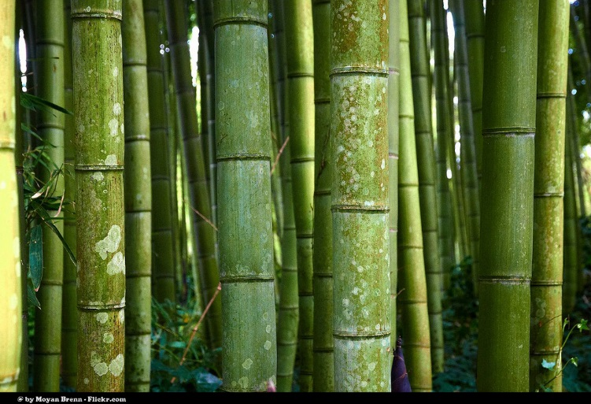
4th
Some types of bamboo can grow almost a metre a day! They are the fastest growing plants in the world.
You could investigate:
how fast a sunflower or bean grows in a week;
how far across your playground a bamboo would grow in a day, a week or a month;
How fast you grow in a year.
Photo courtesy of (Moyan_Brenn@flickr.com) - granted under creative commons licence - attribution

Slide 6
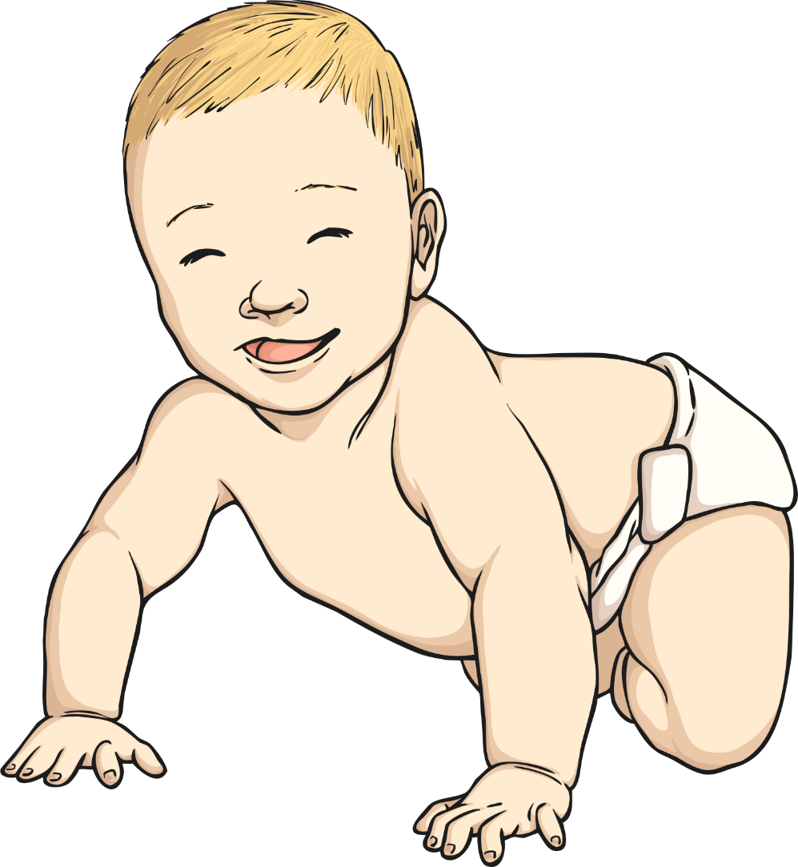
5th
There are 206 bones in an adult human's body but babies are born with about 300 bones! As a child grows, some of their bones fuse together.
You could investigate:
which bones fuse together;
why babies need bones that are not fused together;
at what age the different bones change.

Slide 7
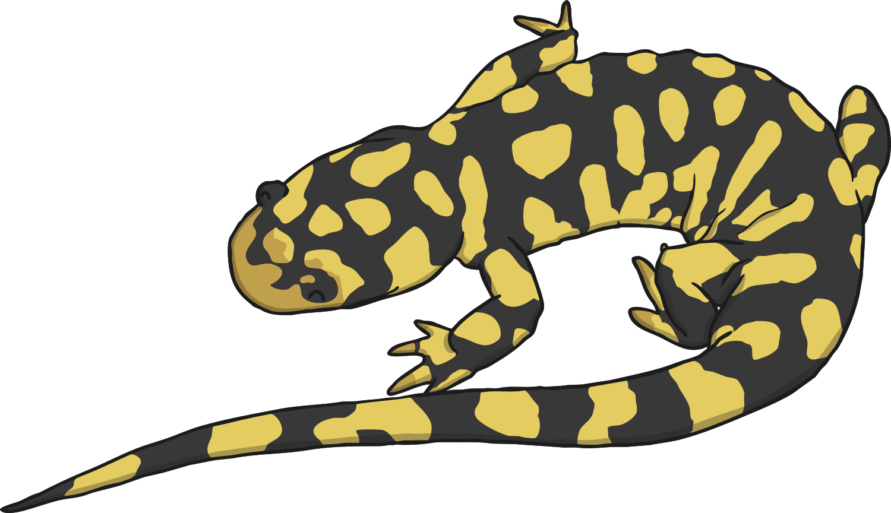
6th
The world's largest amphibian is the Chinese giant salamander. It can grow up to 5ft (about 152cm) in length! It lives in rocky mountain streams in China, and is critically endangered.
You could investigate:
the difference between your height and the giant salamander's length;
the stages of the giant salamander's life cycle;
the size of the largest of other amphibian species, such as frogs, toads or newts;
the size of the world's smallest amphibian.

Slide 8
7th
The loudest sounds produced by a living animal are made by blue whales. Their calls have been detected from as far away as 530 miles! They can reach over 180 decibels.
You could investigate:
how loud a sound you can make! Use a sound sensor to find out;
the loudest sound made by a land animal;
which makes a louder sound: humming, clapping or stamping your feet.

Slide 9
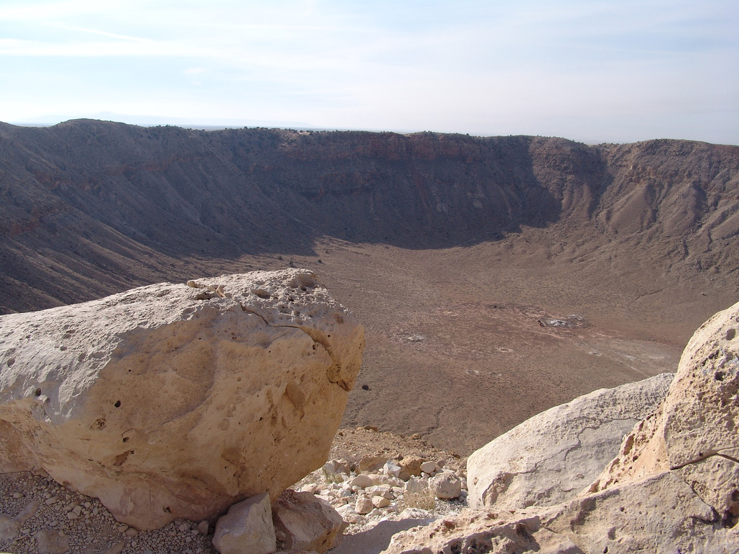
8th
The best preserved meteor crater in the world is found in Arizona, America. It is 1.2 km across and 175 m deep. It is known as the Barringer Crater and was named after Daniel Barringer, the mining engineer who discovered it in 1902.
You could investigate:
how the size of craters can be changed by dropping a ball from different heights into a tray of flour;
where the largest crater in the world is;
how craters are made;
what meteors are.
Photo courtesy of (hummingcrow@flickr.com) - granted under creative commons licence - attribution

Slide 10
9th
There is enough DNA in an average person’s body to stretch from The Sun to Pluto and back 17 times! There are about 37 trillion cells in the human body, each containing coiled DNA molecules. On average, human DNA molecules are about 5cm long when uncoiled.
You could investigate:
how DNA determines your inherited features and traits;
how DNA is useful;
your family tree.

Slide 11
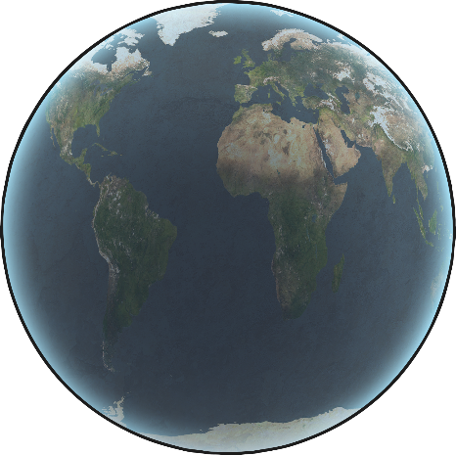
10th
All the planets in the solar system could fit in the space between The Earth and The Moon! The Moon's orbit around The Earth is elliptical, and when The Moon is at its furthest point from The Earth, the space between is big enough to fit every other planet in.
You could investigate:
the size of each planet and make a scale model;
The Moon's orbit around The Earth, and find out when it is closest to you;
the way the shape of The Moon appears to change as it orbits The Earth.

Slide 12
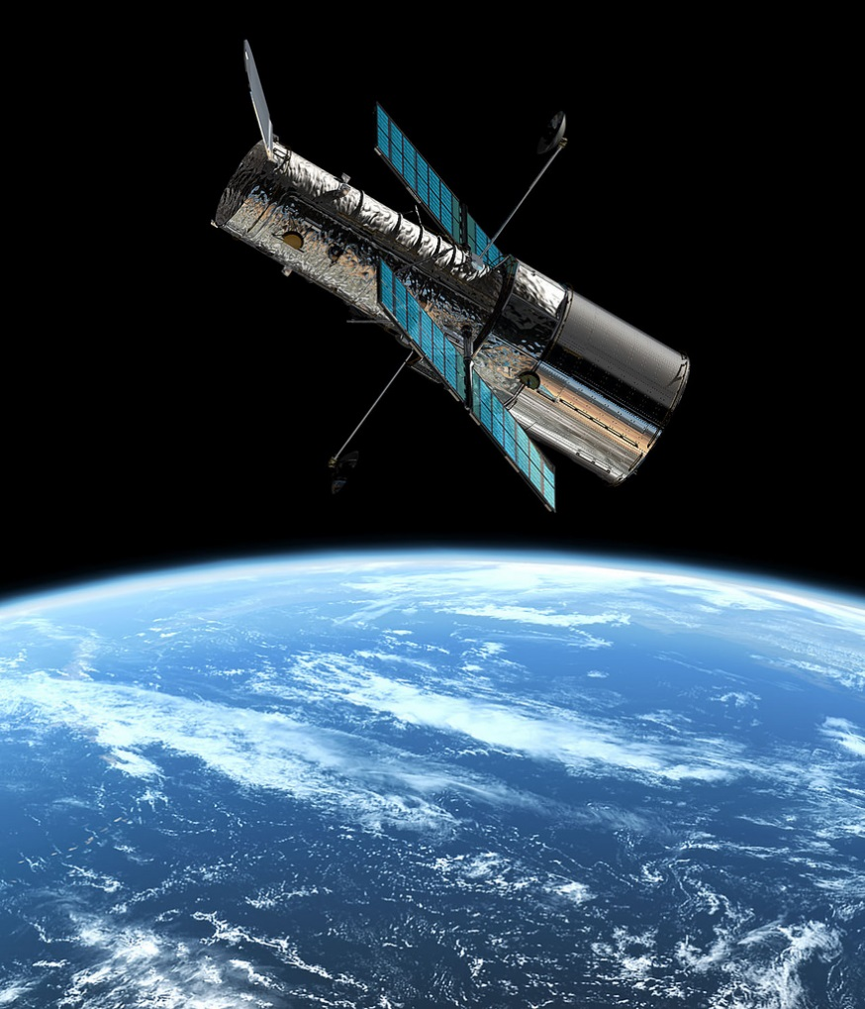
11th
The Hubble Space Telescope weighs around 11,000 kg, is 13 m long and cost $2.1 billion to originally build. It orbits the Earth at 28,000 km an hour, capturing images of galaxies that are many light years away.
You could investigate:
when the Hubble Space Telescope was launched;
which objects the HST cannot capture images of, and why;
who the HST is named after, and what he is famous for.
Photo courtesy of (Hubble Space Telescope/ESA@flickr.com) - granted under creative commons licence - attribution

Slide 13
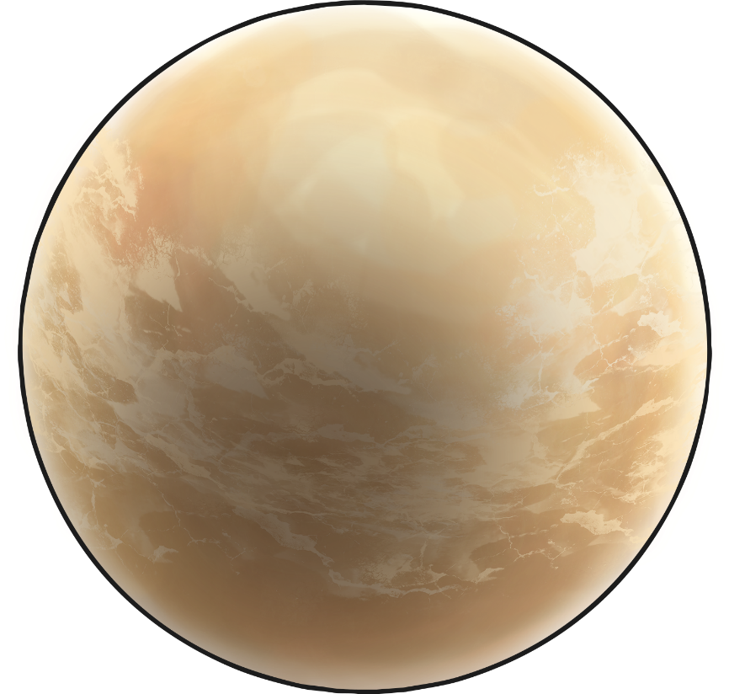
12th
The hottest planet in the solar system is Venus, with an estimated surface temperature of 462°C. Even though Mercury is closer to The Sun, Venus has an atmosphere made of carbon dioxide which traps heat from The Sun and heats up the planet like a greenhouse.
You could investigate:
the effects of extra carbon dioxide in The Earth's atmosphere;
the difference in average temperature between Venus and The Earth;
which is the coldest planet in our solar system.

Slide 14
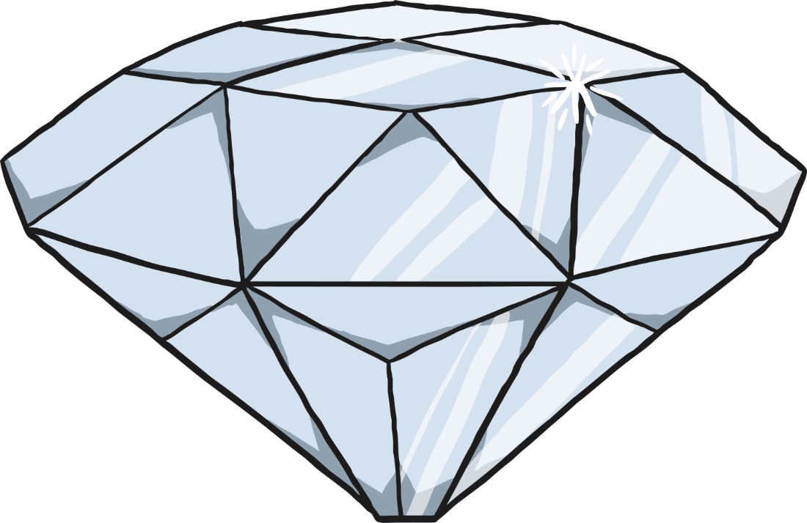
13th
Diamond is the hardest naturally occurring substance on Earth. However, a mineral called lonsdaleite, that has been found in meteors, is harder than diamond.
You could investigate:
the hardness of different rocks;
what diamonds can be used for;
when lonsdaleite was discovered and who it was named after.

Slide 15
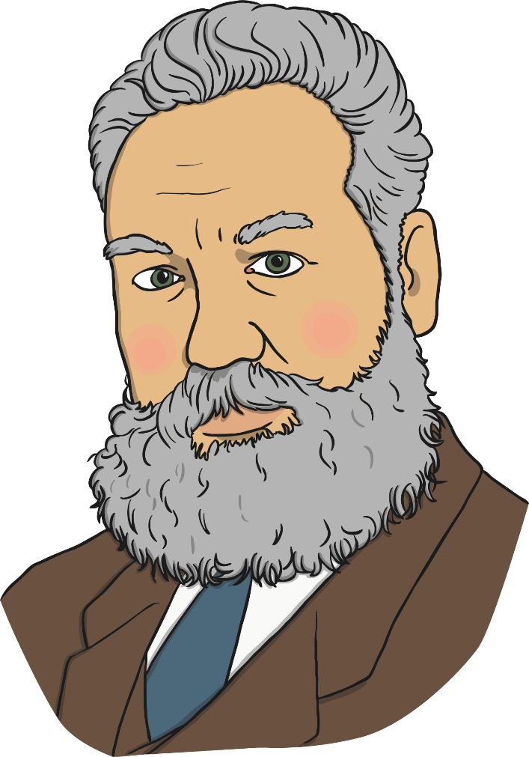
14th
Alexander Graham Bell, who invented the telephone, also set a world water-speed record of over seventy miles an hour at the age of seventy-two. Along with his assistant, Frederick Baldwin, he set the record in 1919 in Canada in a hydrofoil they had invented.
You could investigate:
the current water-speed record;
how you could make the fastest model boat in your class;
how hydrofoils work;
how streamlined shapes move through water faster than non-streamlined shapes.

Slide 16
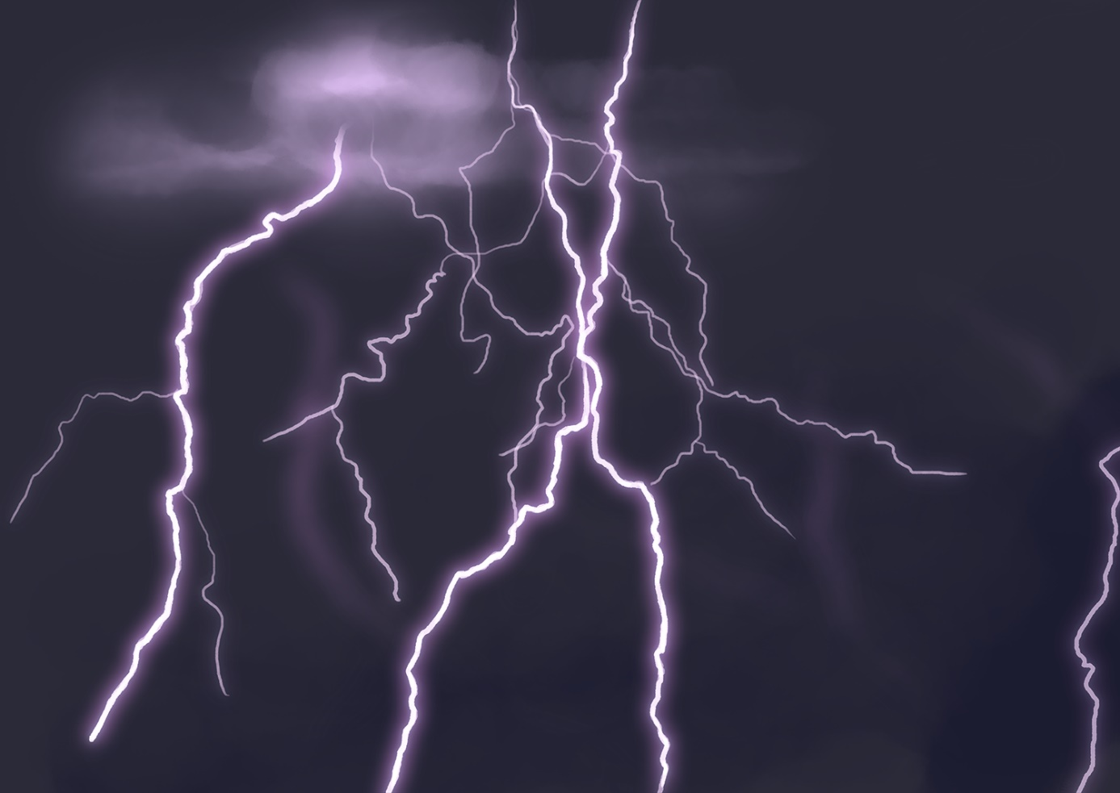
15th
A bolt of lightning is about 30,000°C; about five times hotter than the surface of the Sun!
You could investigate:
how lightning conductors work;
what causes lightning;
the temperature of the Sun below its surface.

Slide 17
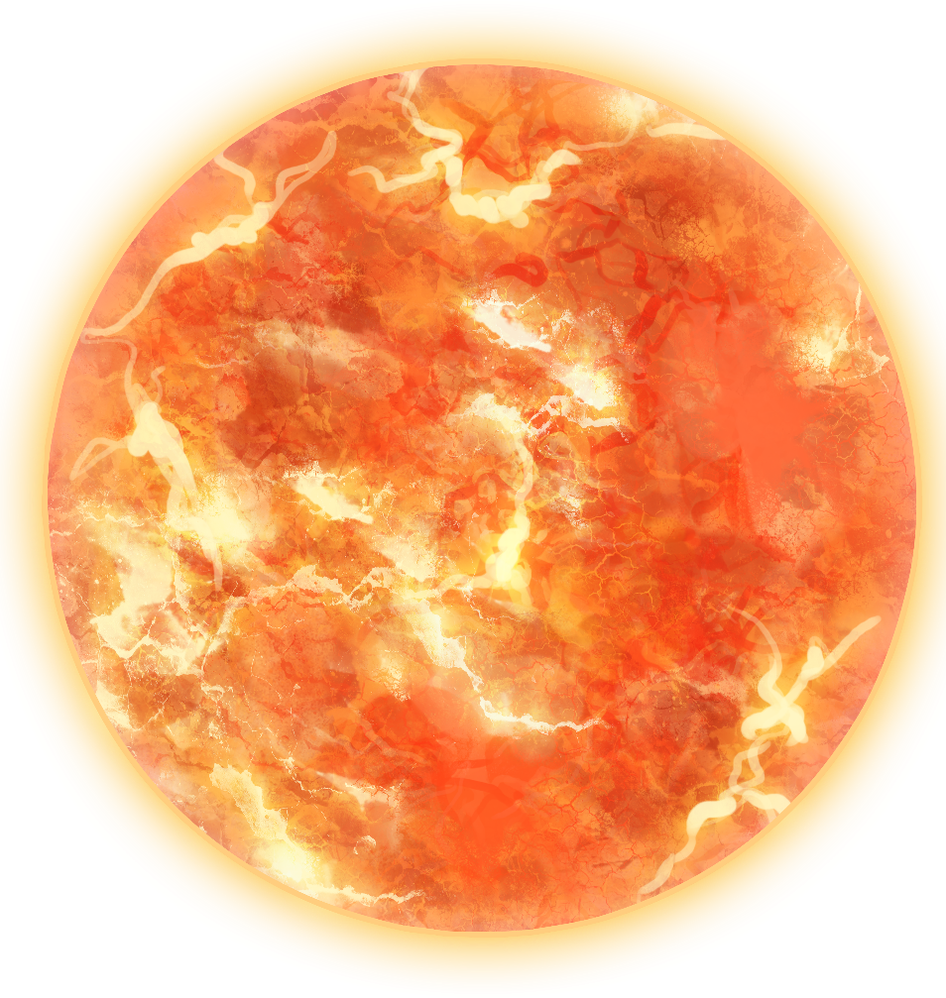
16th
Sunlight takes about 8 minutes and 20 seconds to reach the Earth. It travels at around 300 000 km per second!
You could investigate:
how far or how many times you could walk or run around the playground in 8 minutes and 20 seconds;
why it is dangerous to look directly at the Sun;
which sun cream is most effective, by spreading the same amount of different brands of sun cream on coloured paper and leaving them in sunlight for a week. Remove the sun cream and see which cream protected the original colour of the paper the best! (Warning! Never test sun creams on your own skin.)

Slide 18
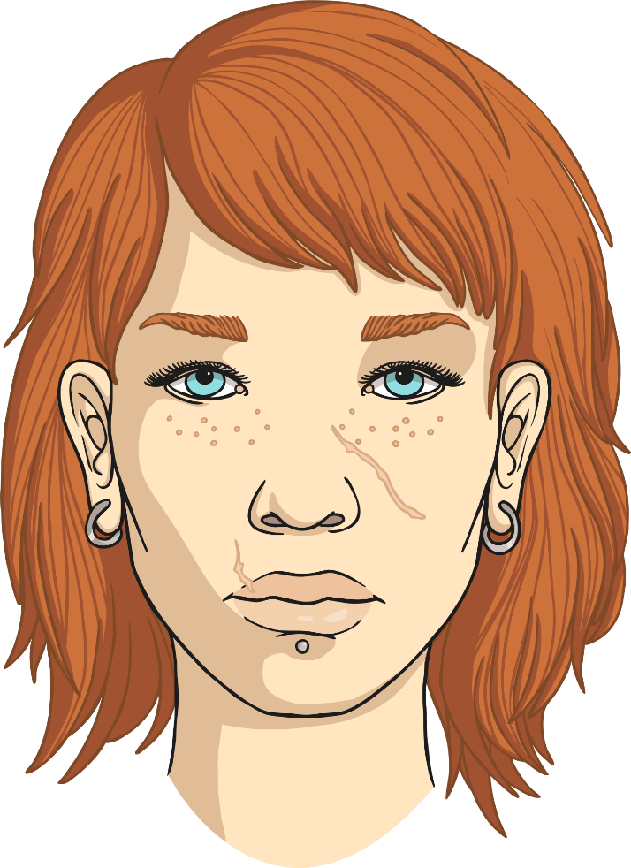
17th
Our eyeballs stop growing when we reach adolescence, but our nose and ears always continue to get bigger! This is because they are made of cartilage which is elastic, and the effect of gravity over the years causes them to stretch and look bigger.
You could investigate:
how a baby grows in its first year;
the difference in the size of your ears or nose compared to those of a younger child;
how much your fingernails grow in a week or a month.

Slide 19
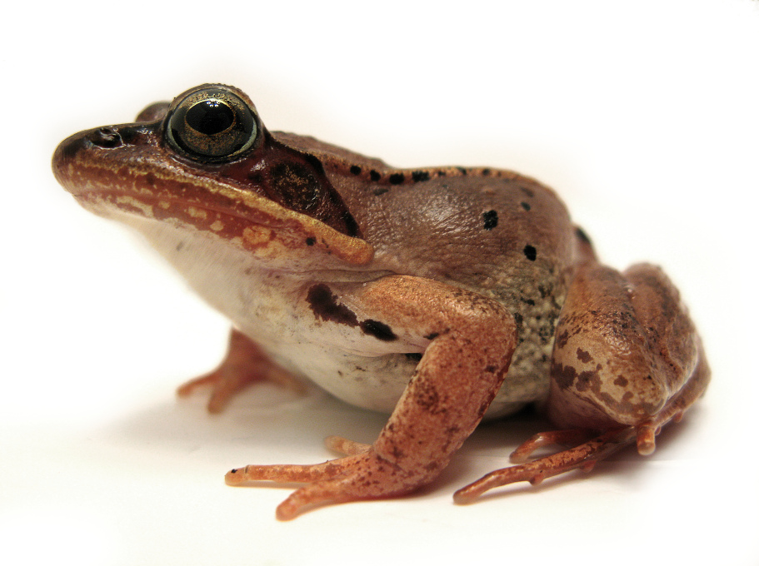
18th
Some species of frogs can survive the experience of being frozen! The American wood frog buries itself under the fallen leaves in the winter. As the temperature falls below 0°C, the wood frog starts to freeze. Its heart even stops beating! As the weather warms up in spring, the wood frog thaws out and its heart starts beating again.
You could investigate:
the freezing and melting points of different materials;
the life cycle of a frog;
how other species hibernate in the winter.
Photo courtesy of (DaveHuth@flickr.com) - granted under creative commons licence - attribution

Slide 20
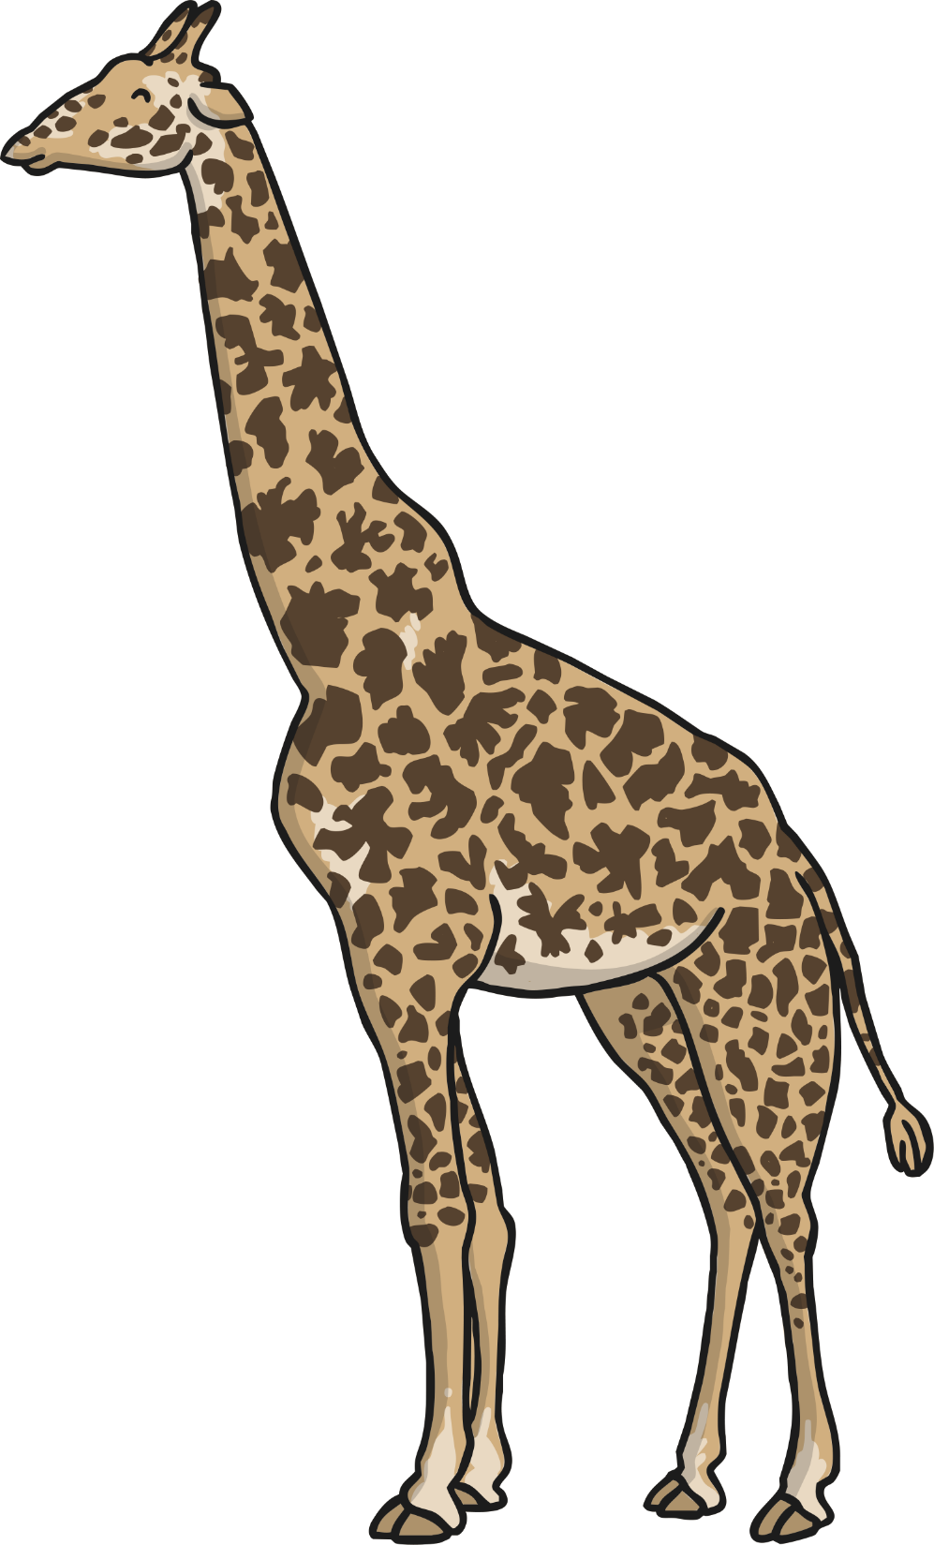
19th
A giraffe's neck contains the same number of vertebrae as a human. Both giraffes and humans have 7 vertebrae, but each of a giraffe's vertebrae can be as long as 25cm.
You could investigate:
what the function of the giraffe's long neck is;
whether the length of an animal's neck has a link to its height;
what a giraffe eats and what eats giraffes, then use this information to construct a food chain.

Slide 21
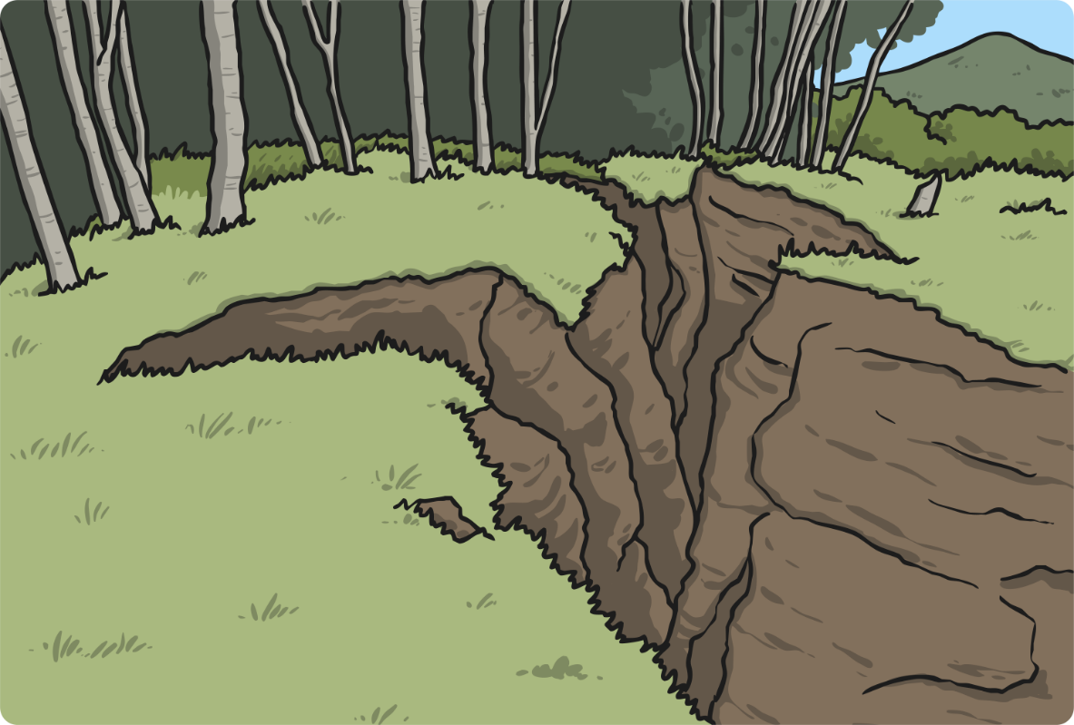
20th
Every year, seismologists (earthquake scientists) estimate that there are over one million earthquakes! Around 20,000 are large enough to be properly detected and measured.
You could investigate:
the places in the world that are most likely to experience earthquakes;
how people create earthquake-proof buildings;
what is the strongest structure you can make using marshmallows and toothpicks! Place your structure in a bowl of jelly and shake it as if it is in an earthquake. Is your structure earthquake-proof?

Slide 22
21st
Alfred Nobel invented dynamite in 1866. A French newspaper called him 'The Merchant of Death' as a result of this invention, and he was very upset by this. He founded the Nobel Prizes that are awarded for Science, Literature and Peace as a way of being remembered for something other than his invention of dynamite.
You could investigate:
some of the famous scientists who have won Nobel Prizes;
who people in your class think should win your class 'Nobel Prizes';
the dangerous outcomes of Alfred Nobel's experiments with dynamite.

Slide 23
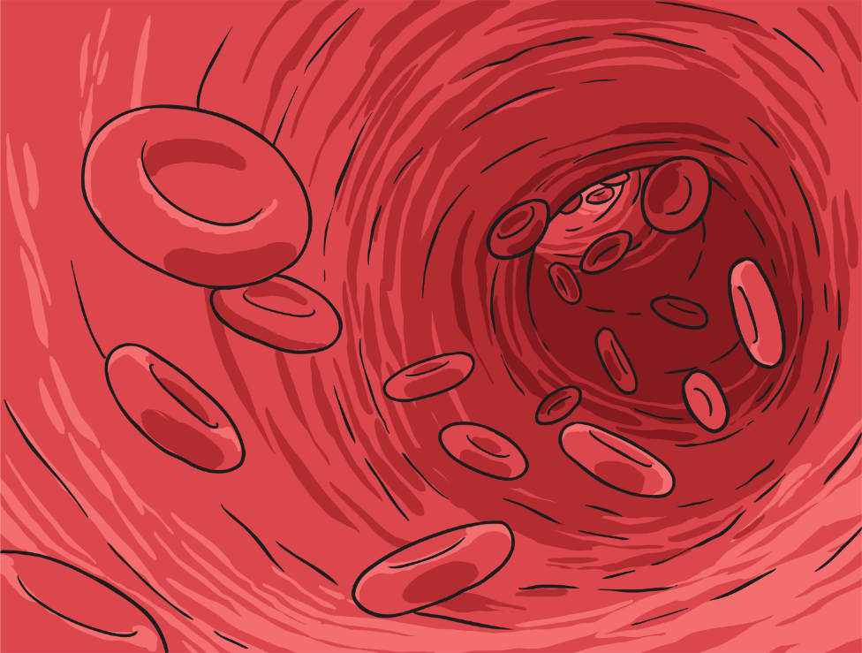
22nd
An individual blood cell takes on average about 60 seconds to make a complete circuit of the body. This is based on the average resting heart rate of 70 beats per minute.
You could investigate:
what your resting heart rate is and what it is after exercise;
the names and functions of different blood cells;
whether you could complete a circuit of your playground in 60 seconds.

Slide 24
23rd
There are more living organisms on the skin of each human than there are humans on the surface of the earth! Most of these
micro-organisms are too small to see with the naked eye and are not usually harmful...some are even helpful!
You could investigate:
the most effective way to wash your hands;
ways that micro-organisms can be helpful to us;
what some micro-organisms look like through a microscope.

Slide 25
24th
When helium is cooled to almost absolute zero (-273°C), the lowest temperature possible, it becomes a super-fluid. This is a liquid with unusual properties; it can flow against gravity and will pour up and over the edge of a container!
You could investigate:
the coldest natural temperature ever recorded on The Earth;
the properties of a liquid at room temperature;
who discovered absolute zero.

Slide 26
25th
Clouds may look weightless, but scientists estimate that an average cloud weighs about the same as 80 elephants! That's around 450,000 kg or 450 tonnes of water floating above your head!
You could investigate:
how clouds are formed-evaporate water and allow it to condense on cling film;
the stages of the water cycle;
how much a litre of water weighs. Use this information to find out how much water is in the average cloud.

Slide 27
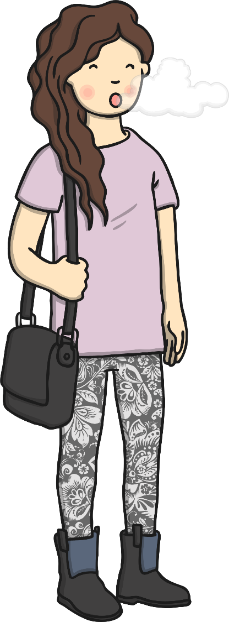
26th
Humans breathe on average between 5 million and 8 million times a year!
You could investigate:
how many times you breathe in a minute, then use this to work out how many times you breathe in an hour, a day or a week;
how your breathing changes during and after exercise;
the gases that you breathe in and out.

Slide 28
27th
The human femur (thigh bone) is stronger than concrete! It is the longest and strongest bone in the body.
You could investigate:
the most common cause of femur fractures;
how X-rays create images of bones;
whether the length of the femur links with a person's height.

Slide 29
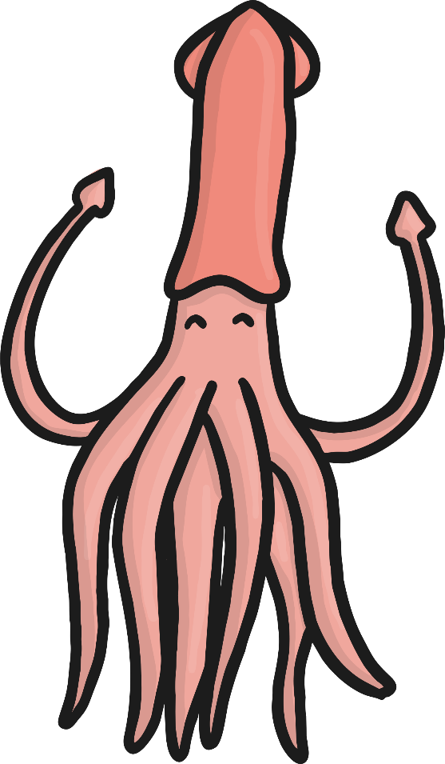
28th
The colossal squid has the largest eyes of any creature in the world. Each eye measures 28cm across - about the size of a dinner plate!
You could investigate:
how your pupil changes when it is dark;
why the colossal squid's large eye would be useful in the dark depths of the ocean;
how light enters the eye enabling animals to see.

Slide 30
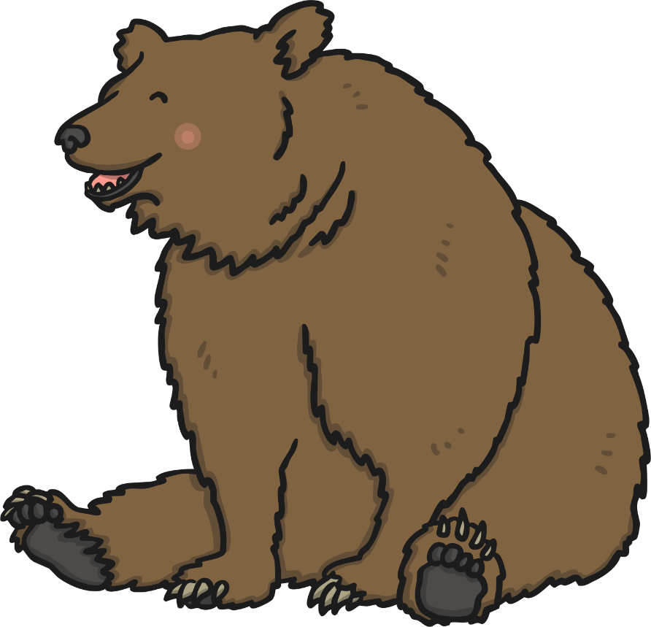
29th
Bears have more teeth than adult humans. Most adults have 32 teeth, while bears have 42.
You could investigate:
whether the size or types of teeth that animals have has any link with the food they eat;
the function of different types of teeth;
ways you can look after your teeth.

Slide 31
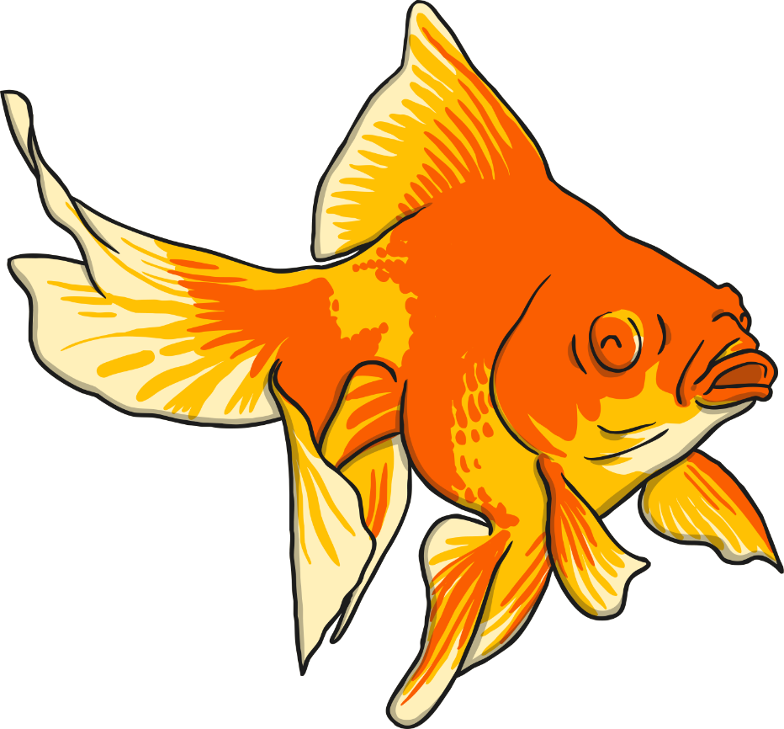
30th
Goldfish can see more than humans! Goldfish have different receptors in their eyes which allow them to see ultraviolet and infrared light as well as the visible spectrum of colours that humans can see.
You could investigate:
the uses of ultraviolet and infrared light;
other animals that can sense different waves of light;
the visible spectrum, by using a prism to split white light into the colours that we can see.

Slide 32
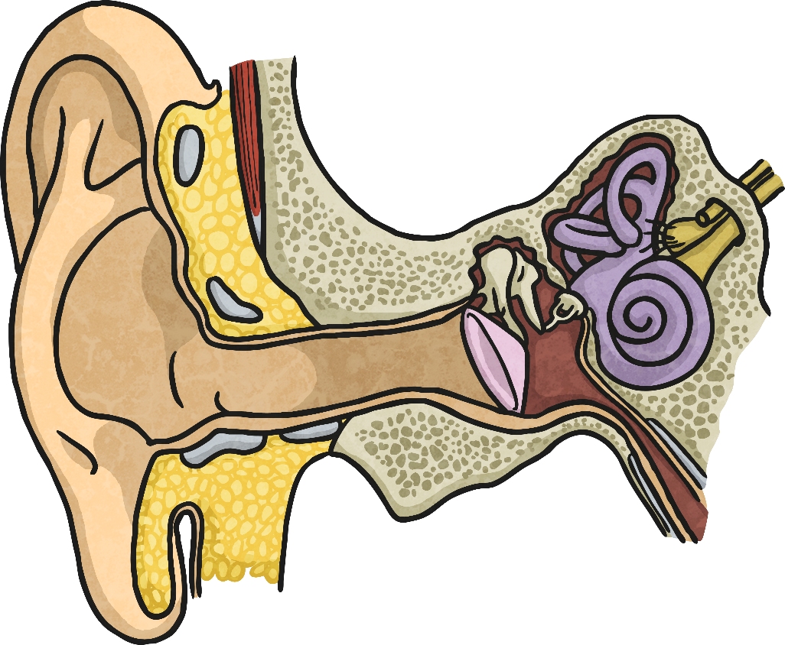
31st
The three smallest bones in the human body are found inside the ear. Known as the hammer, anvil and stirrup, they could all fit on a penny at the same time! These bones vibrate, passing sound waves from the air to the cochlea and the brain.
You could investigate:
how sounds get quieter as you move further away from the sound source;
how sounds travel;
how hearing aids work.

