Slide 1
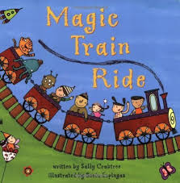
THE MAGIC TRAIN RIDE Summer Term2

Slide 2
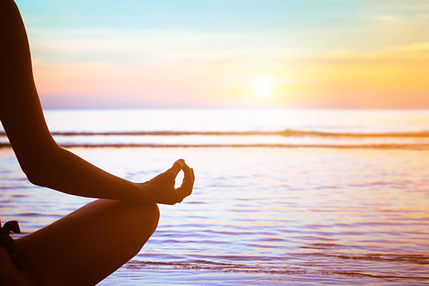
PERSONAL SOCIAL AND EMOTIONAL DEVELOPMENT
How will we teach this?
Transition Sessions in Y1
Discussions around preparing for Y1
Stories about change, new challenges
Square breathing, counting to 10, using language of emotions
Talk and play with staff members across the school.
Tea party with Mr Barritt – opportunity to talk, engage in back and forth conversations with different member of staff.
Use of puddle suits- to practice getting dressed independently.
To begin to negotiate and solve problems without aggression or adult support.
To show resilience and perseverance in the face of challenge.
To show a ‘can do’ attitude.
To put uniform on and do up zippers, buttons and buckles with minimal support.
To listen to the ideas of other children and agree on a solution and compromise.
To have strong friendships.
Compromise
Vocabulary:
Resilient
Resolve
Listen
Friendships
Breath work

Slide 3
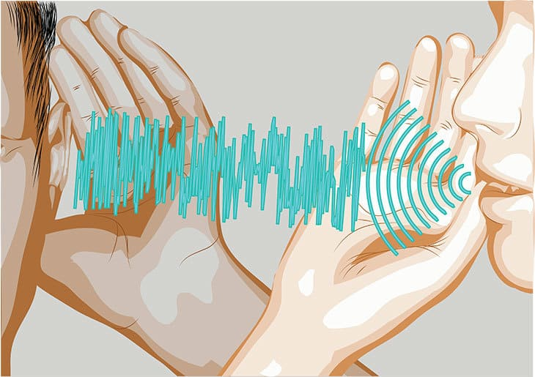
Key Vocab: Train, ticket, fast, slow, underwater, creatures, space, aliens, jungle, journey, magical, ingredients, recipe, destination.
COMMUNICATION and LANGUAGE
Listen attentively and respond to what they hear with relevant questions, comments and actions when being read to and during whole class discussions and small group interactions.
Make comments about what they have heard and ask questions to clarify their understanding.
Hold conversations when engaged in back-and-forth exchanges with their teacher and peers.
Use of sentence starters for the register daily.
Ask children extending questions to make them think and respond using connectives.
Select vocab for topic and introduce and revise across the half term.
.
Vocabulary:
Story time
Because
Listen carefully
Vocabulary
Who? Where? When? Why? What?

Slide 4
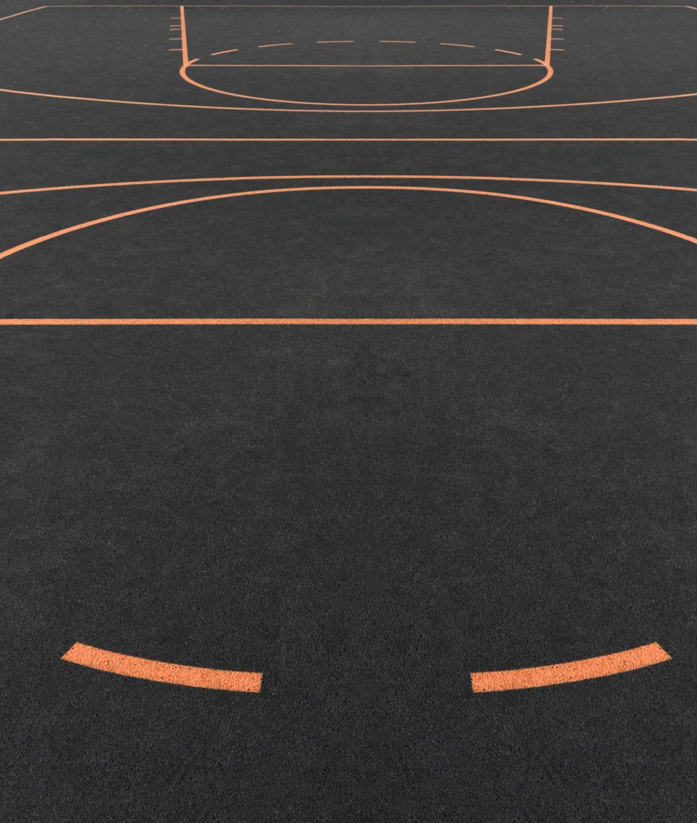
Physical development
We will be learning about:
Preparations for Sports Day- relay races, throwing at targets, running races, speed jumping over cones with two feet.
Magic Train Ride Dance- put together a sequence of movements to the Magic Train Ride music.
Move expressively,
Negotiate space and obstacles safely, with consideration for themselves and others.
Demonstrate strength, balance and coordination when playing.
Move energetically, such as running, jumping, dancing, hopping, skipping and climbing.
Dance
Sequence
Vocabulary:
Aim
Run
Challenge
Move
Target
Throw

Slide 5
reading
Key Texts:
The Magic Train Ride
Rumble in the Jungle
There’s a Tiger in the Garden
Tiddler
Commotion in the Ocean
How to Catch a Star
Whatever Next!
Non-fiction text about recipes/baking
We will continue to cover reading skills through Read Write Inc, Talk Through Stories, Book Club and topic specific texts:
Vocabulary
Phonics
Decodable texts
Predict
Explain
Retrieve
Summarise
Vocabulary:
Phonics
Characters
Green Words
Fred Talk
Red Words
Fred In Your Head

Slide 6
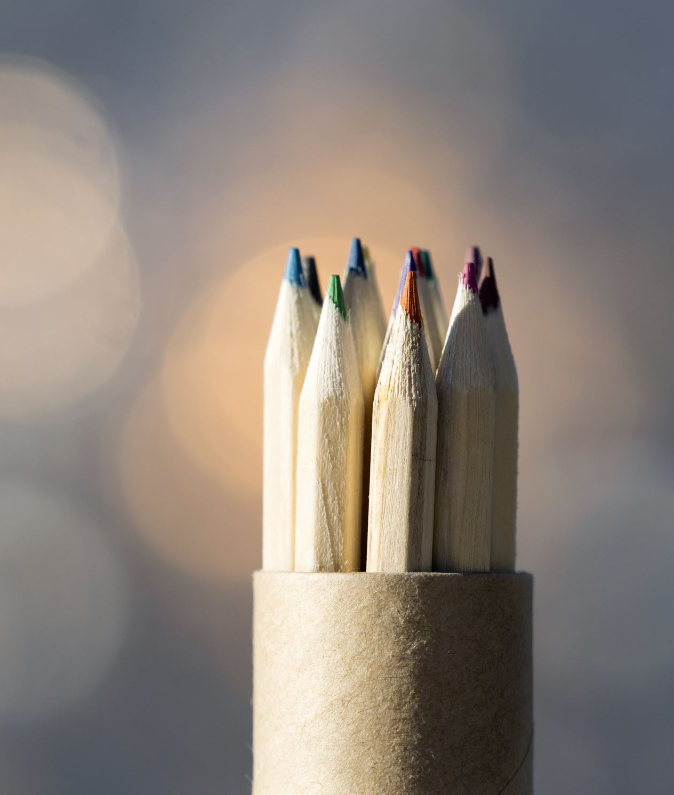
writing
Opportunities for writing:
Daily sentence writing/letter formation practice
Descriptive writing about under the sea, space, jungles, magical fairy woodland
Who am I? writing clues about jungle animals.
Writing recipes for cakes.
Map writing - plan a journey for the Magic Train.
Vocabulary:
Fred Fingers
Capital letter
Finger spaces
Hold a sentence
Full stop
Sounds

Slide 7
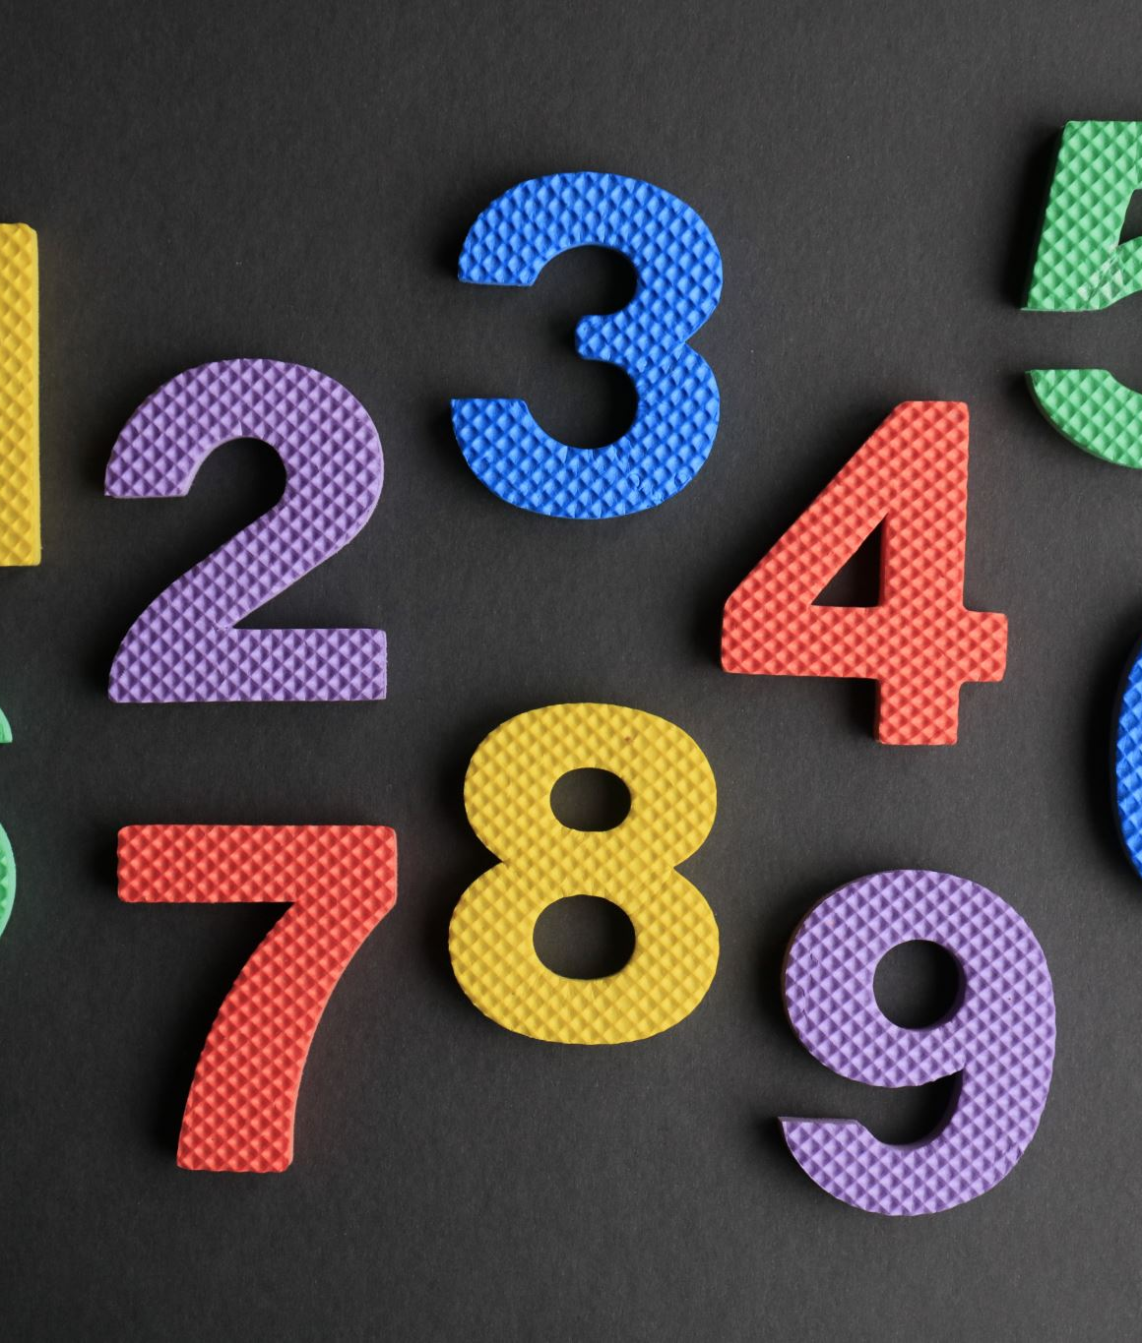
mathEMATICS
White Rose Units:
Sharing and Grouping
Fair sharing, solving problems involving sharing, odd/even
Doubles and halves up to 10.
Counting in 2’s, 5’s and 10’s.
Repeating patterns
Rules of patterns
Create own patterns
Describe positions
Give instructions
Explore mapping
Vocabulary:

Slide 8
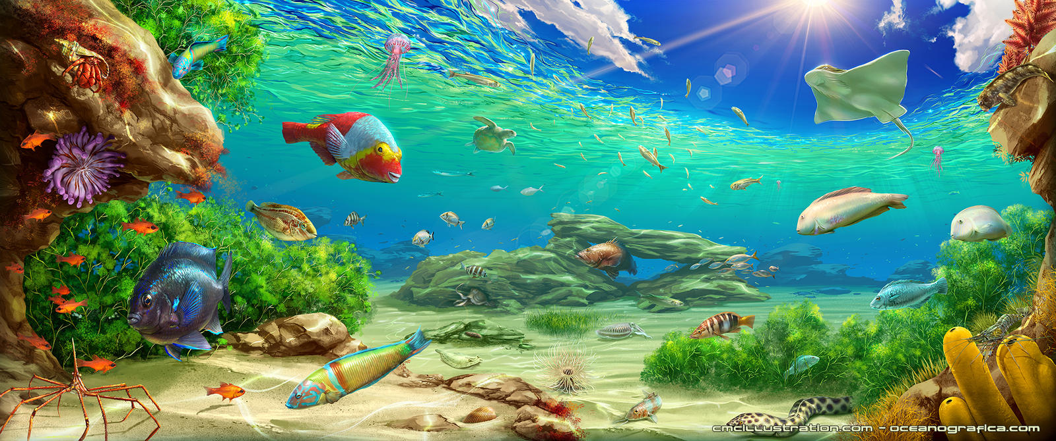
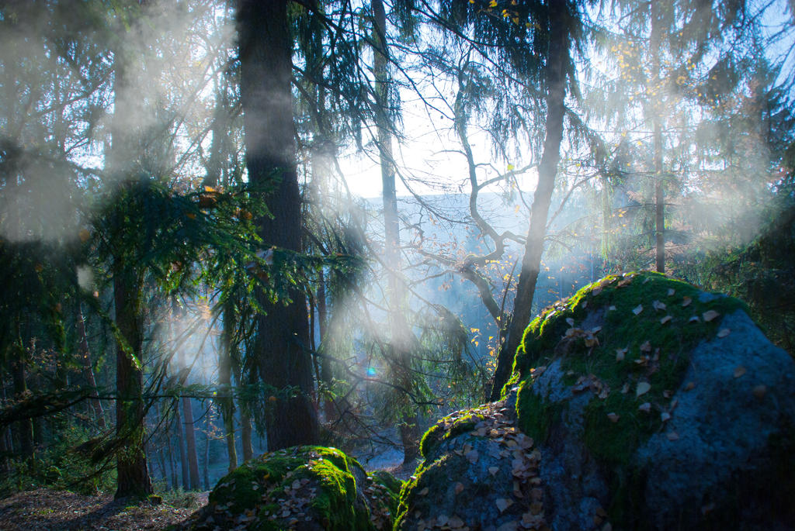
Understanding
THE WORLD
Talk about the lives of the people around them and their roles in society. Know some similarities and differences between things in the past and now, drawing on their experience and what has been read in class. Understand the past through settings, characters and events encountered in books read in class and storytelling.
Talk about the lives of the people around them and their roles in society. Know some similarities and differences between things in the past and now, drawing on their experience and what has been read in class. Understand the past through settings, characters and events encountered in books read in class and storytelling. Explore the natural world around them, making observations and drawing pictures of animals and plants.
Know some similarities and differences between the natural world around them and contrasting environments, drawing on their experiences and what has been read in class.
Space planet
Gravity
Stars rocket
Treasure
Vocabulary:
Astonaut
Creatures
Jungle
Underwater
Camouflage
This Photo by Unknown Author is licensed under CC BY-NC-ND

Slide 9
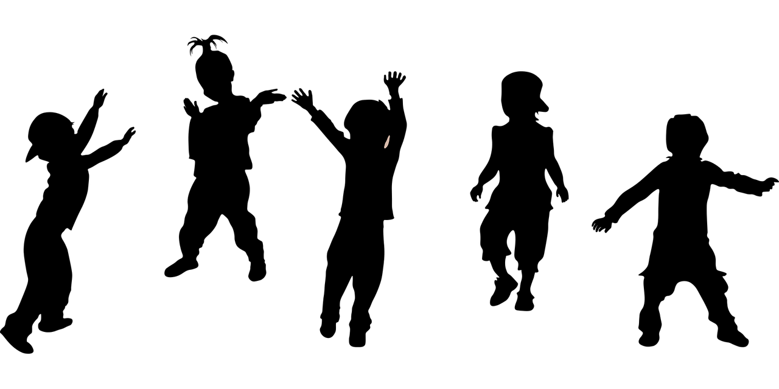
Expressive Art and Design
We will be learning to:
Safely use and explore a variety of materials tools and techniques, experimenting with colour, design, texture, form and function. Share their creations, explaining the process they have used. Make use of props and materials when role playing characters in narratives and stories.
Invent, adapt and recount narratives and stories with peers and their teacher. Sing a range of well know nursery rhymes and songs. Perform songs, rhymes, poems and stories with others and (when appropriate) try to move in time with music
Sing
Rhythm
Vocabulary:
Count the beat Dance
Imagination
Invent

Slide 10
Key Texts will include:
The Magic Train Ride by Sally Crabtree
Commotion in the Ocean by Giles Andreae
The Way Back Home by Oliver Jeffers
Walking through the Jungle by Julie Lacome
Rumble in the Jungle by Giles Andreae
We will learn the song ‘The Magic Train Ride’ and compose a dance.
We will create maps of where trains stop on a local journey through Cornwall.
School trip to Gylly Beach
Children will be able to talk about the difference between evironments such as space, jungles, underwater and our local environment.
Our science investigation will be to investigate how craters are formed on the moon.
We will investigate floating and sinking.
We will be making cakes and learning about ingredients, recipes and basic cooking skills

