Slide 2
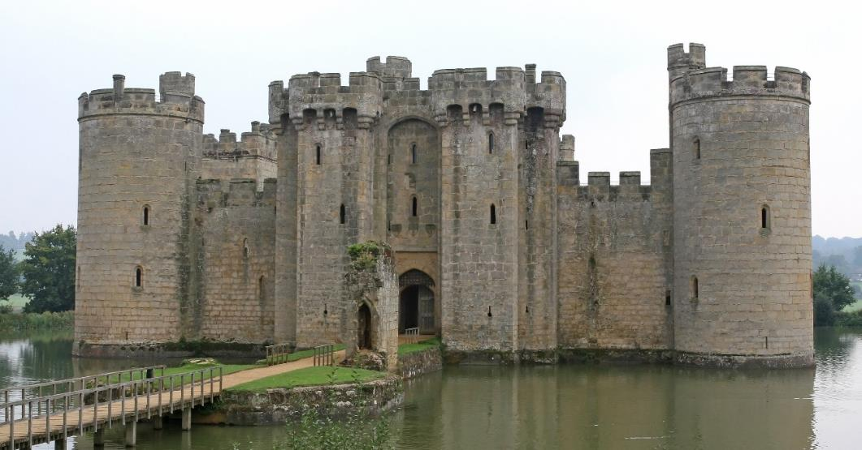
What Is a Castle?
Castles are a type of home. The people who lived in castles were usually kings, queens or lords and their families.
There would also be soldiers, cooks, cleaners and other people who lived inside and helped to look after and protect the king, queen or lord.

Slide 3
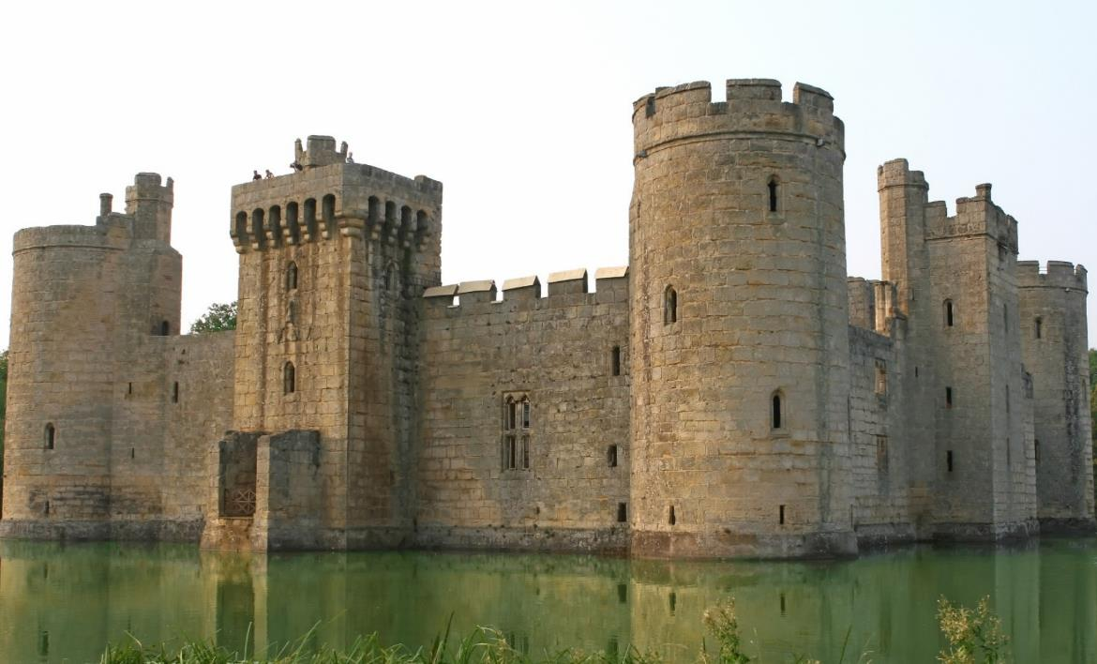
Castles
Castles were designed to keep the people inside safe and to stop enemies from getting in.
Castles have many features to stop people from attacking.
?
Can you spot any in this picture?

Slide 4
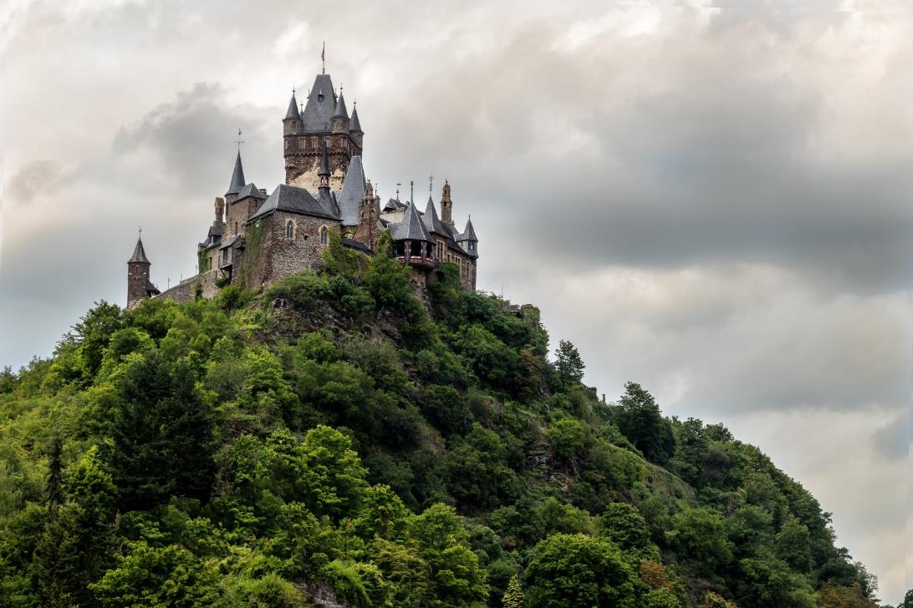
Location
Lots of castles were built on top of hills.
?
Why do you think this was?
It was hard for enemies to run up steep hills to get to the castle.
It gave the people in the castle an excellent view and meant that they could spot enemies a long way off.

Slide 5
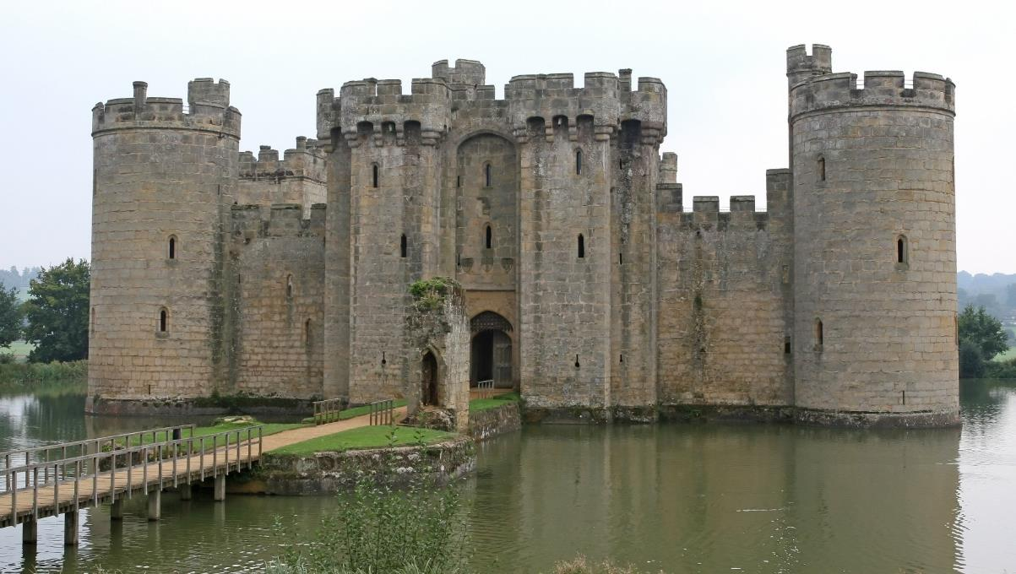
Moat
Some castles had moats. Water completely surrounded the castle.
This made it hard for people to attack it.

Slide 6
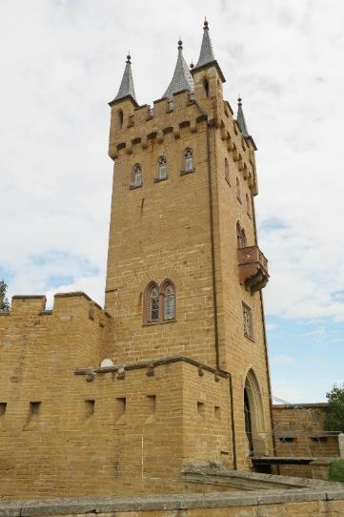
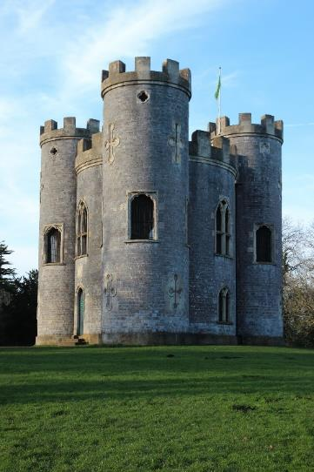
Design
Some castles had flat walls and corners.
Some had rounded walls.
?
Which design do you think was strongest?
Rounded towers without corners were less likely to collapse.
Square towers were more likely to fall if attackers dug away at the base.

Slide 7
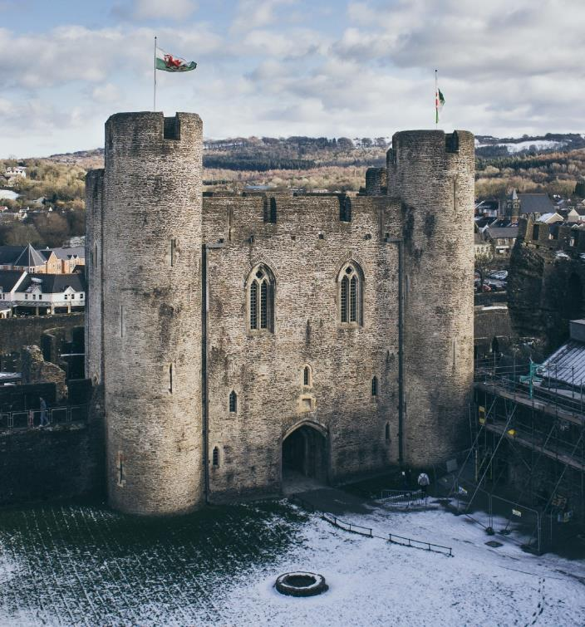
High Walls
It was important that the castle walls were very high.
This made it harder for attackers to climb over the walls.
?
Can you see the tiny people in this photo? This shows us how tall the building is.

Slide 8
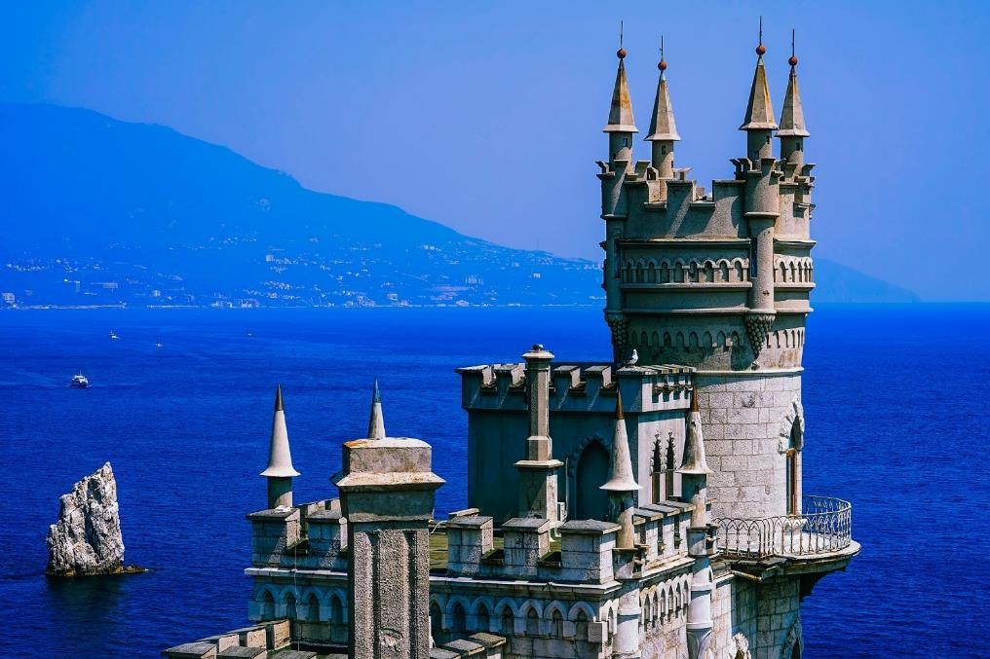
Turrets
Turrets are small towers built on top of a tower or wall in a castle.
The turrets gave great views from different angles.
?
How many turrets can you spot on this castle?

Slide 9
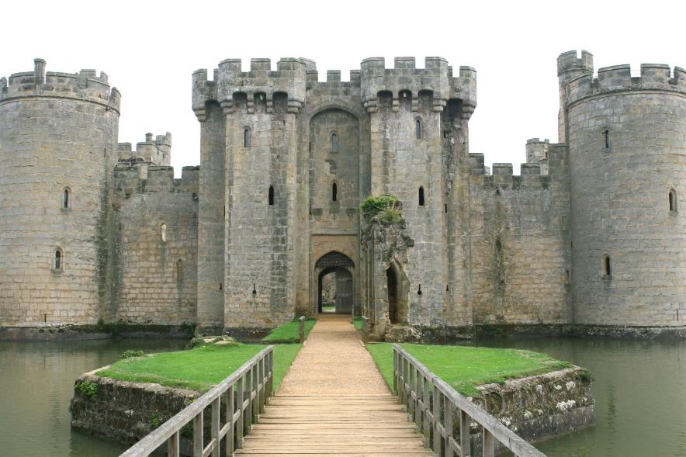
Battlements
At the top of the castle walls were the battlements.
The battlements look a bit like teeth.
?
Can you spot the battlements?

Slide 10
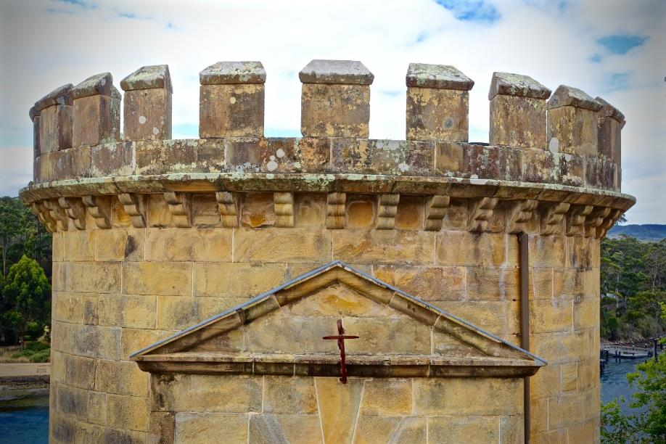
Battlements
The soldiers stood behind the wall and tried to protect the people inside the castle.
They looked through the gaps (called crenels) and shot arrows at any attackers.
They shielded their bodies behind the raised sections (called merlons) to avoid being shot at themselves.
crenel
merlon

Slide 11
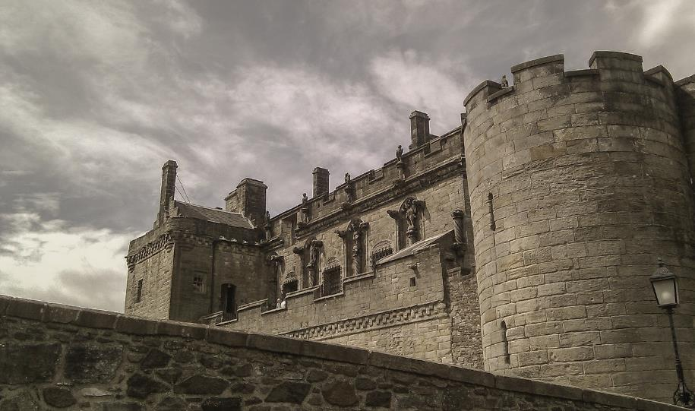
Arrow Slits
Some castles also had arrow slits.
Soldiers could see and shoot arrows through these thin gaps in the wall, without getting shot.
?
Can you spot the arrow slits?

Slide 12
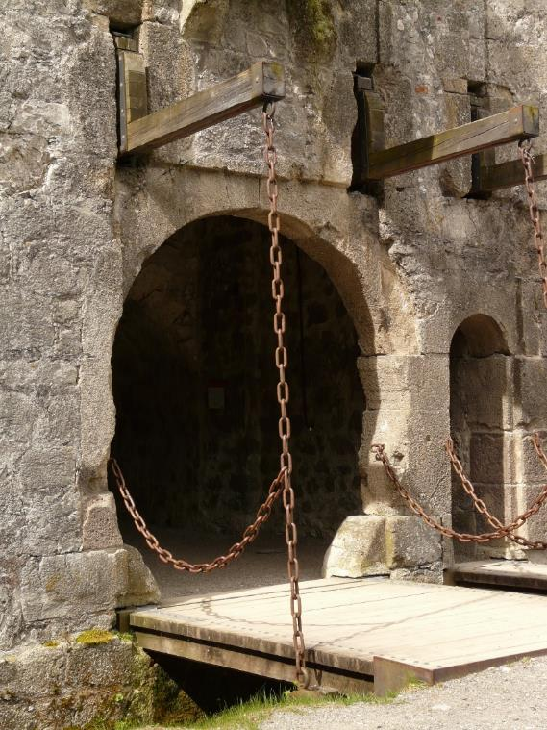
Drawbridge
Lots of castles had a bridge over the moat, that led to the entrance.
The drawbridge could be pulled up to stop enemies from getting across the water and reaching the castle.

Slide 13
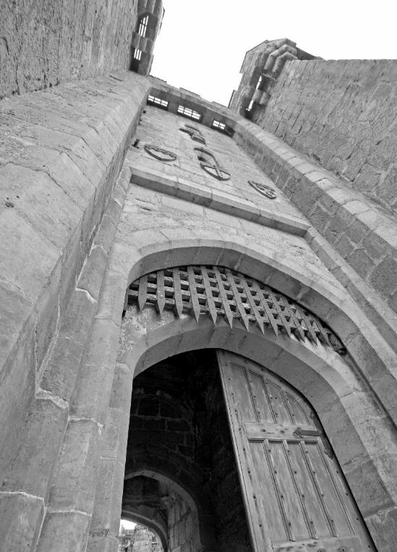
Portcullis
At the entrance to the castle, there was a portcullis covering the door.
This was made of metal or wood.
It was there to protect the door from being set on fire or being bashed in by enemies.
It could be lifted to let people in or out of the castle.
“Bodiam Castle portcullis and machicolations” by [exfordy] is licensed under CC BY 2.0

Slide 14
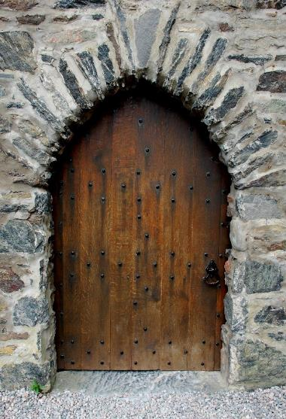
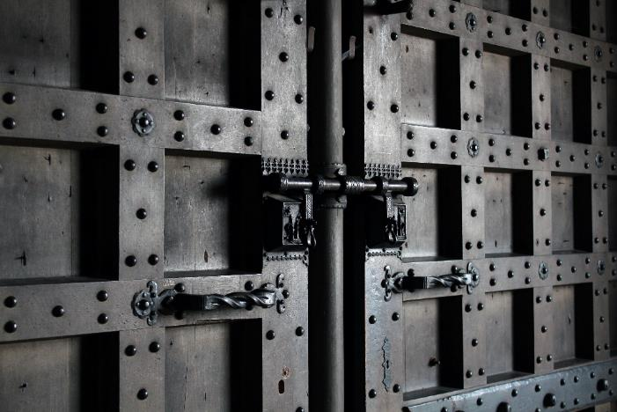
Door
The entrance to the castle was protected by a thick, iron-studded wooden door.
It was big and strong so that enemies could not break the door down and enter the castle.

Slide 15
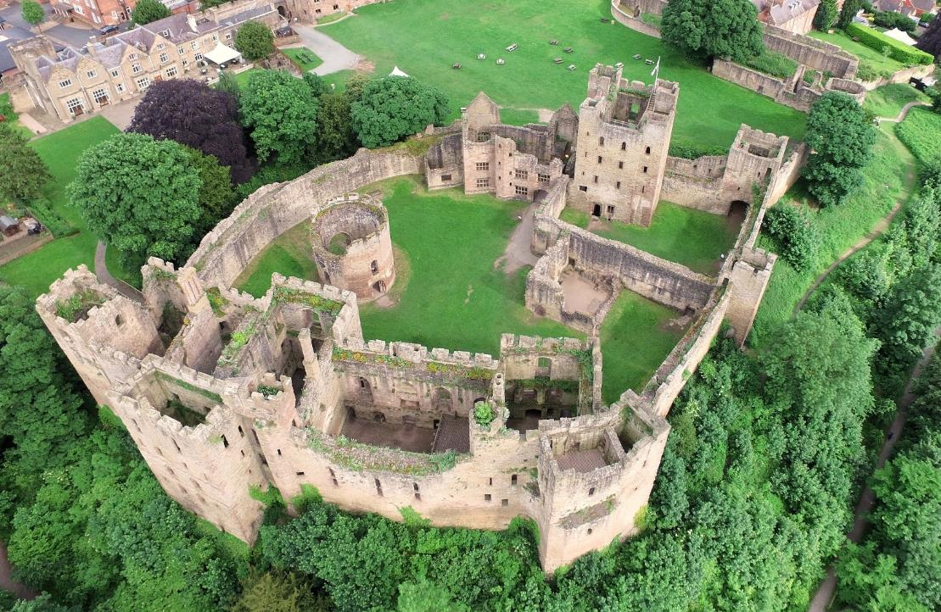
Bailey
Inside the castles walls was the bailey – the area where people lived and worked.
bailey
castle wall

Slide 16
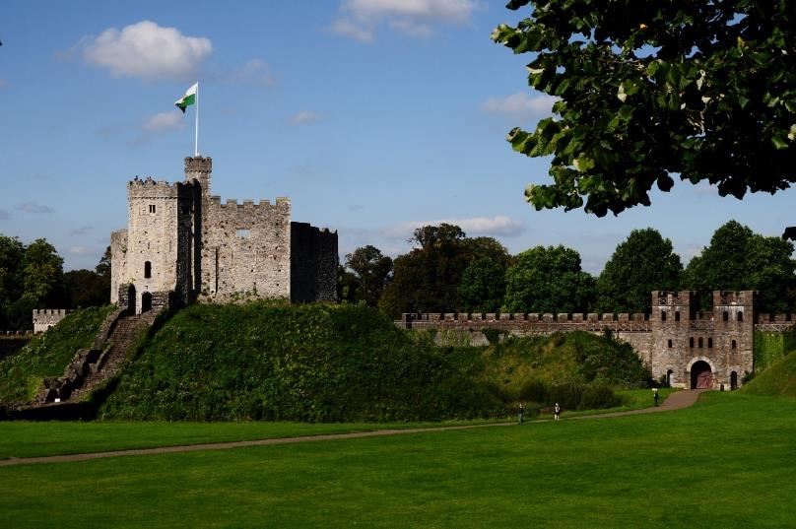
Keep
Inside the castle walls was also the keep.
The keep was the safest part of the castle. The kings, queens or lords could hide here when the castle was in danger.
In some castles, the keep was built on a special mound called a motte.
keep
castle wall
motte

Slide 17
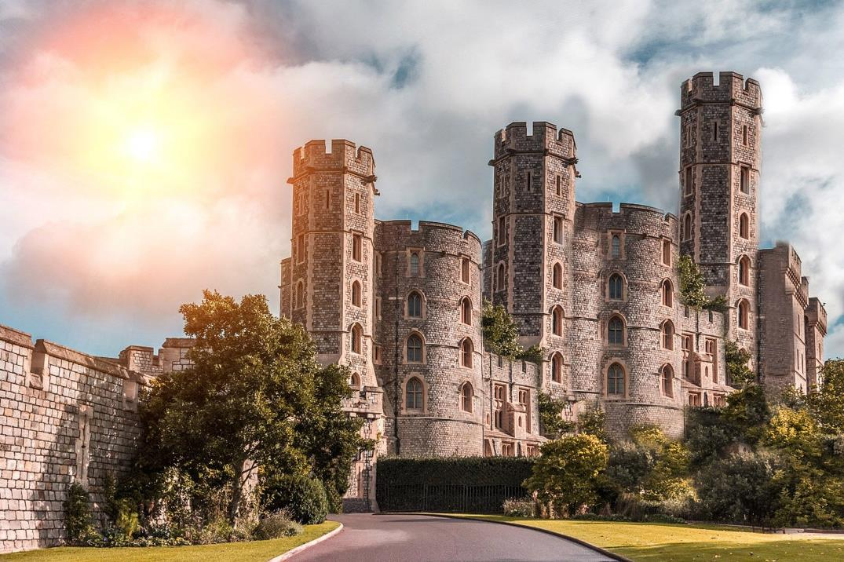
Castles Around the World
Lots of different castles were built in different countries around the world.
There are lots of different styles of castle.

Slide 18
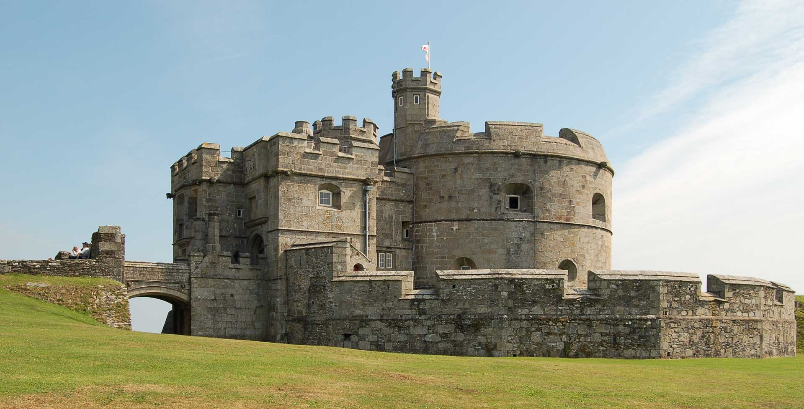
Pendennis Castle

Slide 19
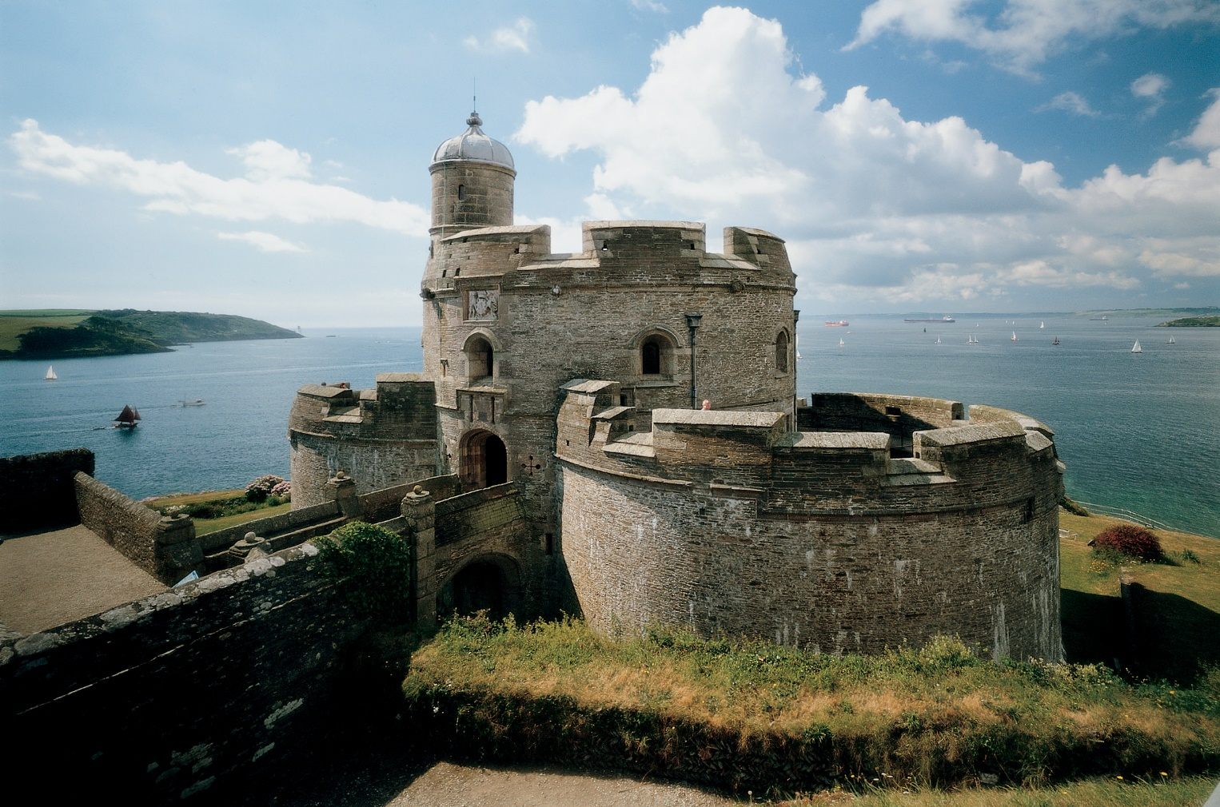
St Mawe’s Castle

Slide 20
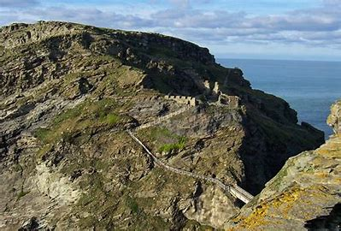
Tintagel Castle

Slide 21
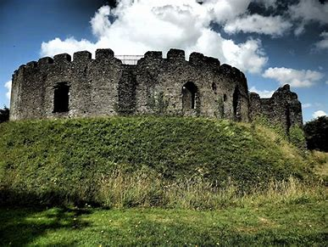
Restormel Castle

Slide 22
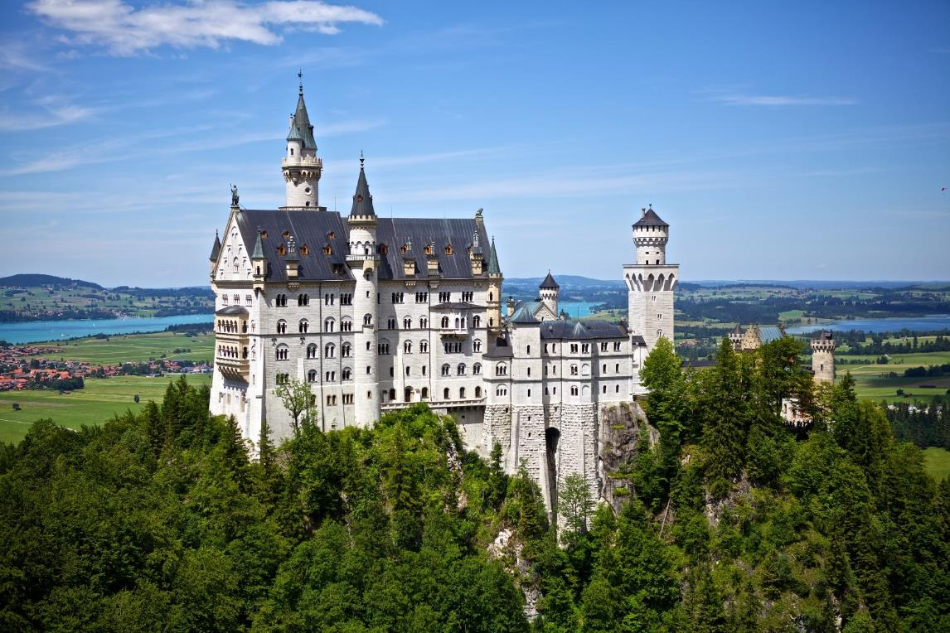
Neuschwanstein, Germany

Slide 23
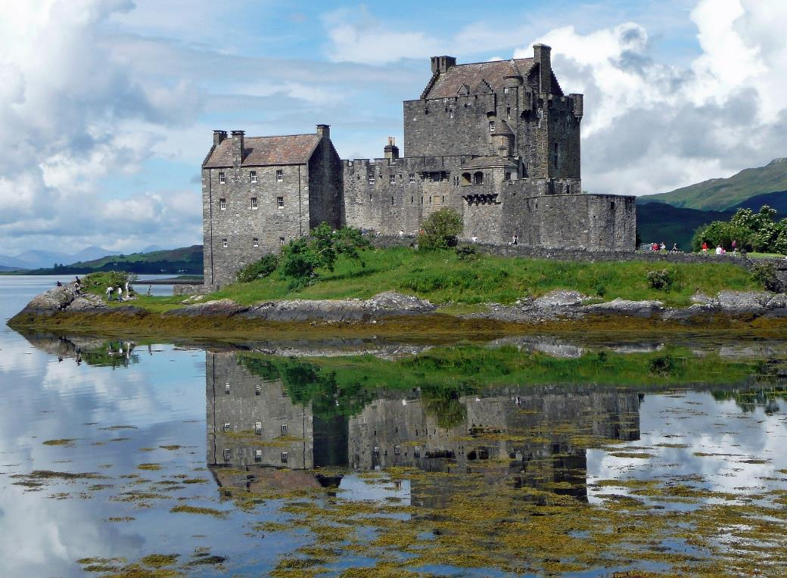
Eilean Donan Castle, Scotland

Slide 24
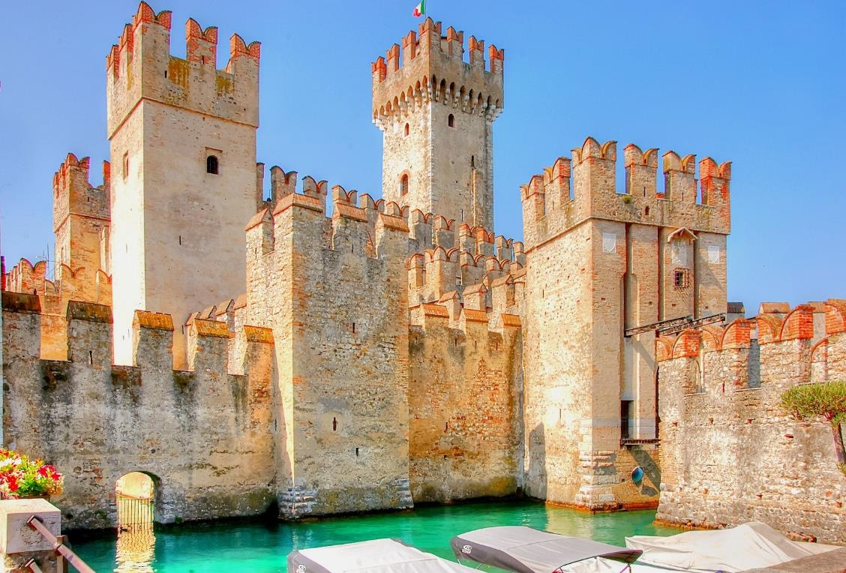
Scaligero Castle, Italy

Slide 25
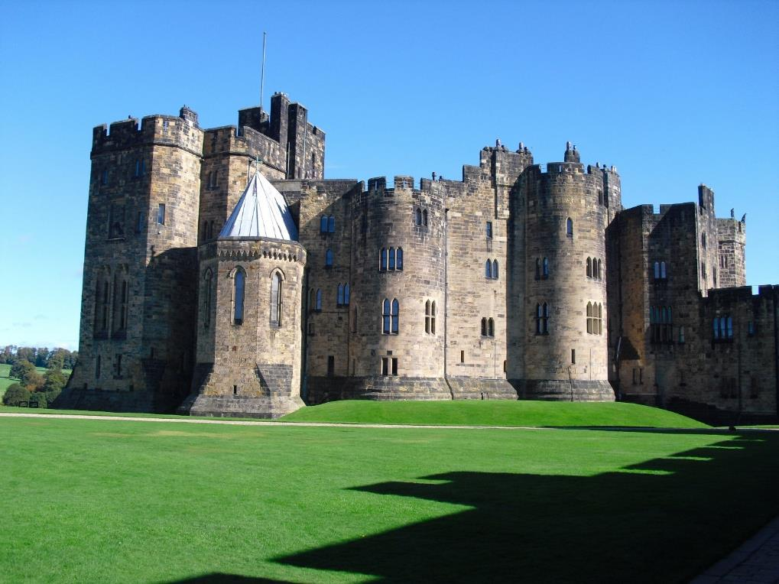
Alnwick Castle, England

Slide 26
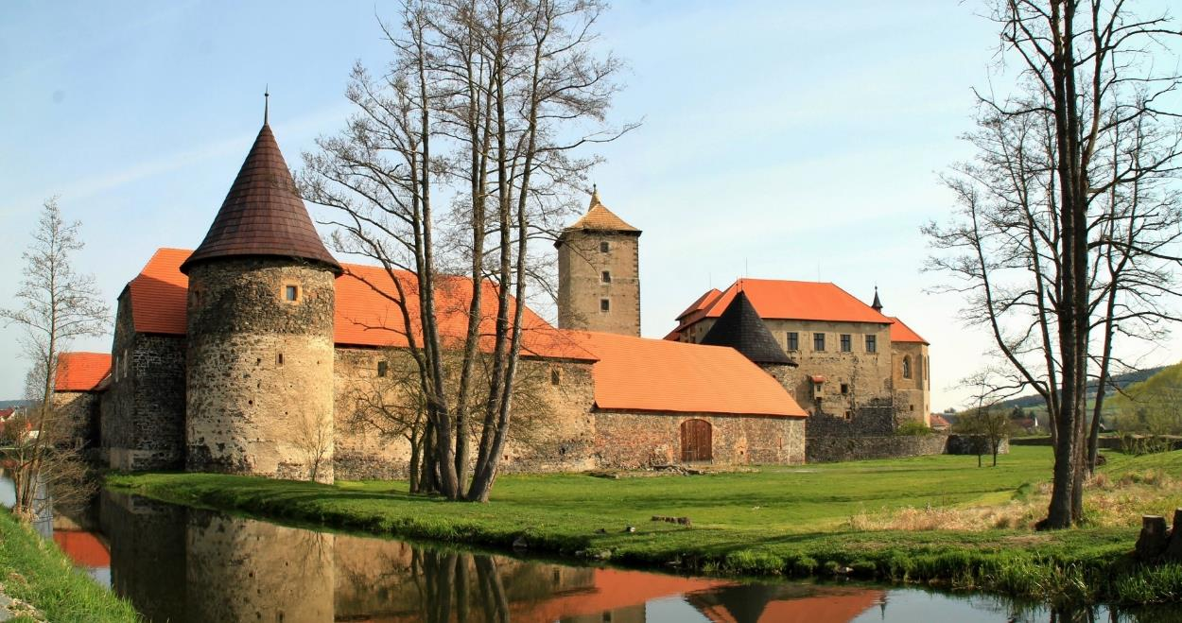
Švihov Castle, Czechia

Slide 27
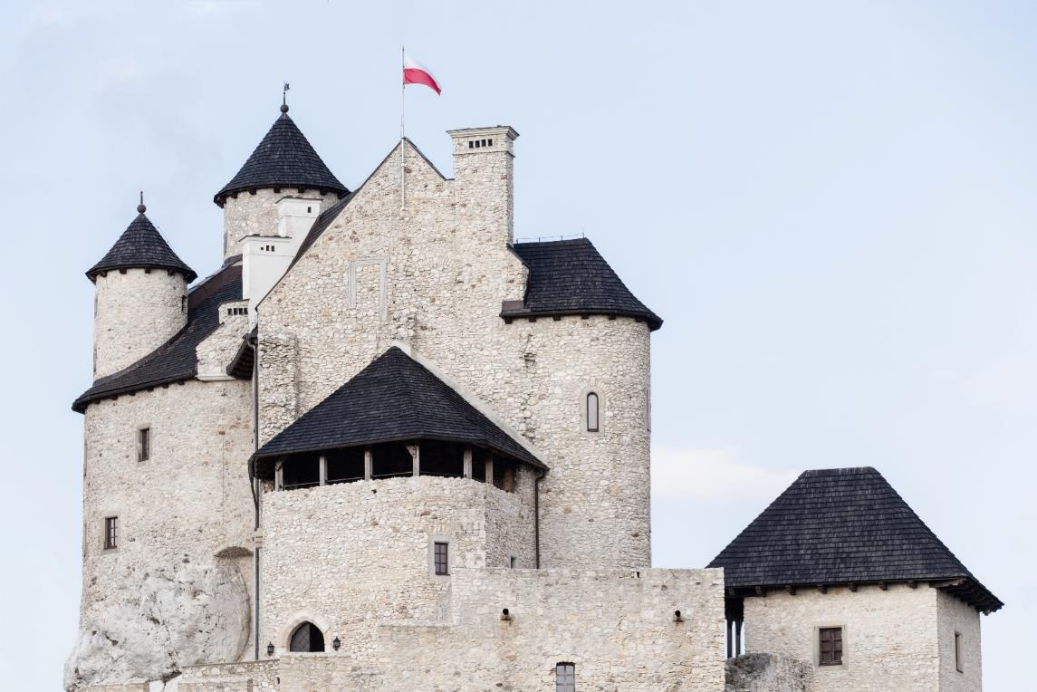
Bobolice Castle, Poland

Slide 28
Swallow’s Nest, Crimea

Slide 29
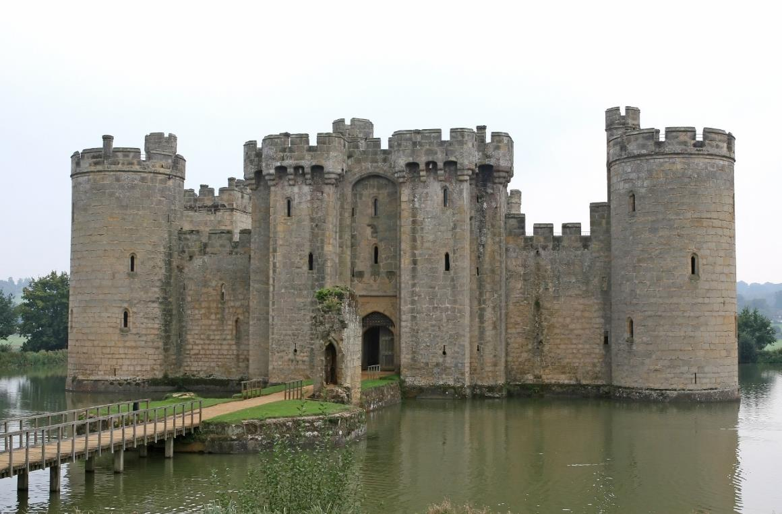
Would You Like to Live Here?
?
Would you like to live in a castle? Why?

Slide 30
