Slide 1
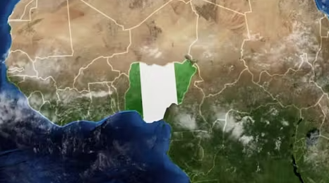
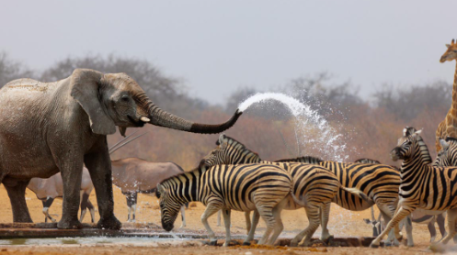
WHERE IN THE WORLD IS NIGERIA?

Slide 2
reading
We will continue to cover the discrete reading skills through a class book and topic specific texts:
Vocabulary and infer
Predict and explain
Retrieve and summarise
Class read: The Butterfly Lion by Michael Morpurgo.
summarise
Vocabulary:
extract
evidence
infer
justify
sport
discipline
compete

Slide 3
WRITING
The text types we are learning about this half term are -
Fiction - Narrative adventure based on The BFG
Non-Fiction – Newspaper reports based on The Wizards of Once.
We will use sentence stacking lessons to learn to collect ideas, use tools to help us expand and improve our writing and learn the techniques for editing and improving our work.
Vocabulary:
sentence, effect, adjectives,
complex sentence, simile, conjunction, dialogue, time adverbials

Slide 4
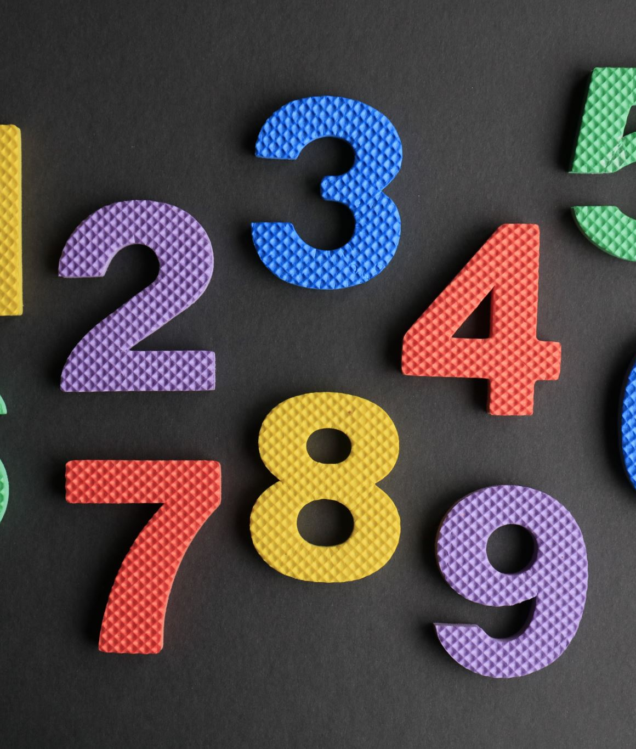
maths
We will be continuing working through our maths units, focusing on fluency skills and then developing our reasoning and problem solving.
Place Value
Addition
Subtraction
hundreds
subtract
Vocabulary:
thousands
tens
take-away
ones
value
minus
plus
add

Slide 5
SCIENCE
We will be learning about how we classify living things. We will look at characteristics of living things, ways to classify them and explore what food chains are.
A vertebrate has a backbone inside its body and an invertebrate does not have a backbone.
Rainforests are the ‘lungs of the earth’, absorbing Carbon Dioxide and producing 20% of the oxygen in the Earth’s atmosphere.
Rainforests are cleared by humans and used for wood, medicines, farming and food.
A drought is a natural change to an environment and is dangerous because living things need water to survive.
prey and predator
vertebrate
Vocabulary:
investigate
mammal
classification
adaptations
food chain
amphibians

Slide 6
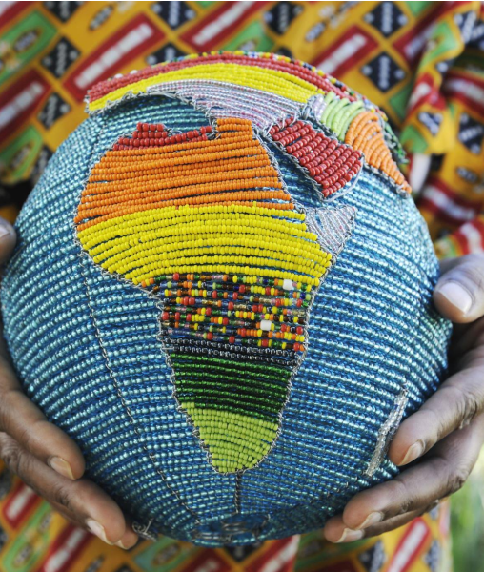
GEOGRAPHY
We will be learning about where in the world Nigeria is.
I can identify the Northern and South Hemisphere I can locate the continent of Africa on a World map I know that Africa is made up of a number of different countries I can locate Madagascar on a map I can identify the physical and human features of Madagascar I can explore the different types of land use in Madagascar.
1-Geography is about Earth's land, water, air, and living things
2- An Environment is everything that is around us, which includes both living and non-living things such as soil, water, animals and plants
3-Physical processes are the natural forces that change Earth's physical features
4-Climate is the average measurements of wind, rain, snow and humidity in an area over a long period of time
Vocabulary:
Northern/Southern hemisphere equator, population, climate, land use, agriculture, North, South, East, West, island
Locate

Slide 7
COMPUTING
We will learn about repetition in shapes and creating shapes and patterns.
Repetition in shapes
That accuracy in programming is important
How to create a program in a text-based language
What ‘repeat’ means
How to modify a count-controlled loop to produce a given outcome
How to decompose a task into small steps
How to create a program that uses count-controlled loops to produce a given outcome
modify
cloning
rotate
Vocabulary:
effects
software
crop
editing
composition

Slide 8
P.s.h.e
We will be learning about:
Importance of respecting ourselves and others
How to make and keep friends
Identify support networks
Strategies for resolving conflicts
Identify what bullying is
Knowing what to do if someone is getting bullied
I dial 999 for emergency help.
Childline telephone is 0800 1111.
Two ways to keep safe online are to never share personal information and always tell a trusted adult when something scares me.
The difference between banter/joking and bullying is that the victim enjoys banter, bullying is upsetting and repeated.
positive
affect
Vocabulary:
respect
resolve
behaviour
support
safety
relationships

Slide 9
d.T.
We will be investigating mechanisms like wheels and axles.
We will also investigate mechanisms: sliders and levers
We will develop skills built up across previous years for ‘Design’, ‘Make’ and ‘Evaluate’. (planning, building and assessing)
Vocabulary:
purpose, research, labelled diagram, features,
materials, components, function, aesthetic

Slide 10
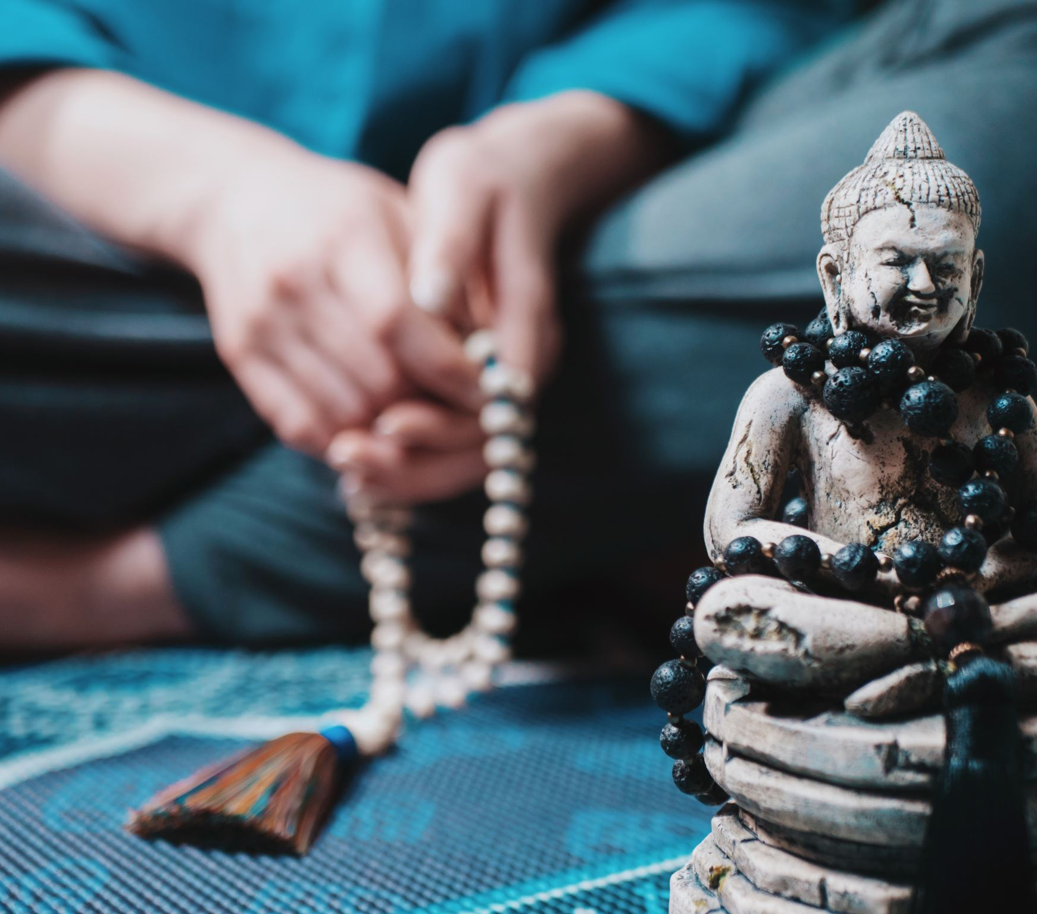
R.e.
We will be learning about making sense of belief:
Recognise what a ‘Gospel’ is and give an example of the kinds of stories it contains
Offer suggestions about what texts about baptism and Trinity mean
Give examples of what these texts mean to some Christians today
We will be learning how to understand the impact of religion
Describe how Christians show their beliefs about God the Trinity in worship in different ways (in baptism and prayer, for example) and in the way they live
Vocabulary:
Gospel, story, truth, moral, belief, Holy Trinity
Baptist, baptise, pray, prayer

Slide 11
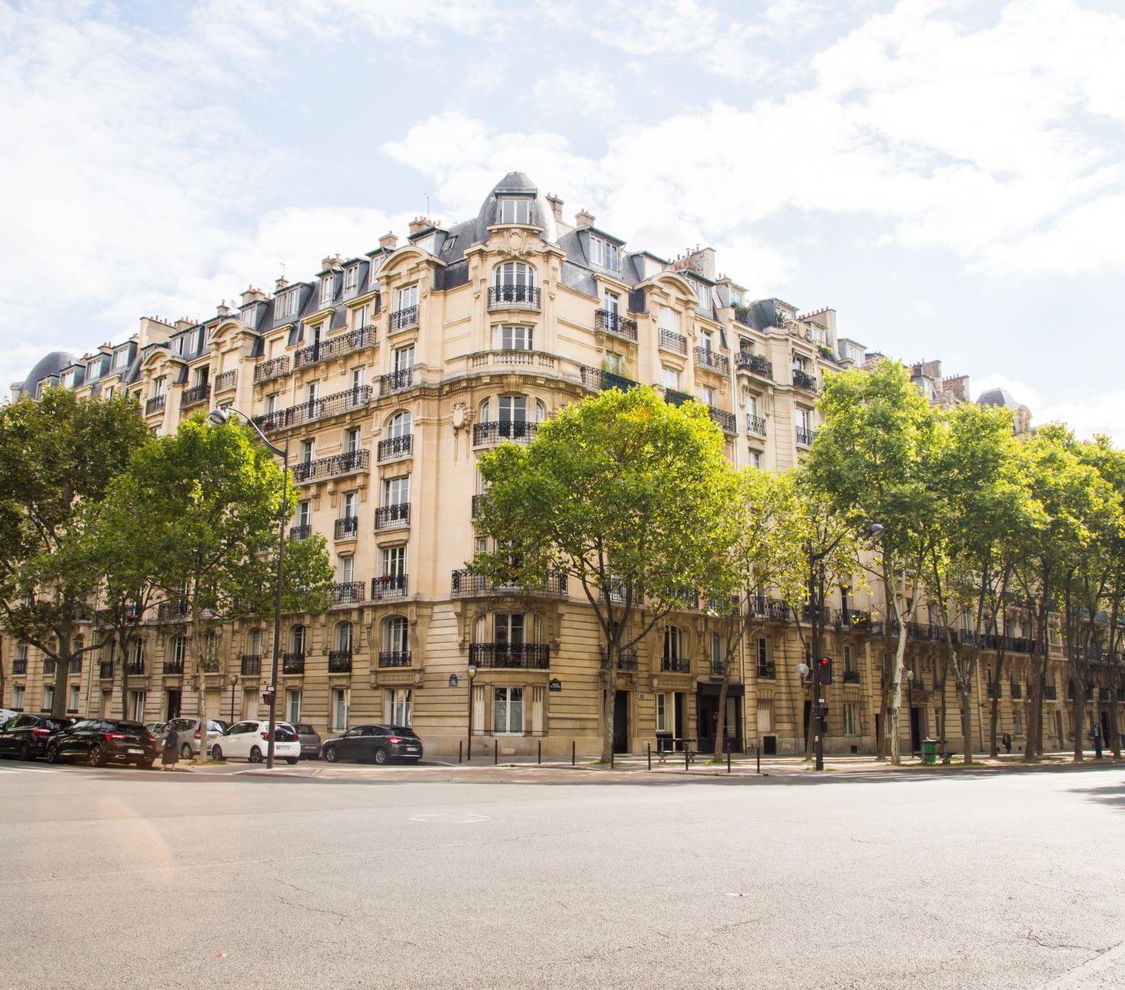
french
We will be learning sounds and phonics to enable us to read and spell.
Unit 1- La Phonetique
Introduce the first set of phonics sounds / phonemes in French.
CH OU ON OI
I IN IQUE ILLE
EAU EUX É È E
QU GNE Ç EN AN
Unit 2- Les Fruits
Name and recognise up to 10 fruits in French.
Attempt to spell some of these nouns.
Ask somebody in French if they like a particular fruit.
Say what fruits they like and dislike.
Vocabulary:
pomme,

Slide 12
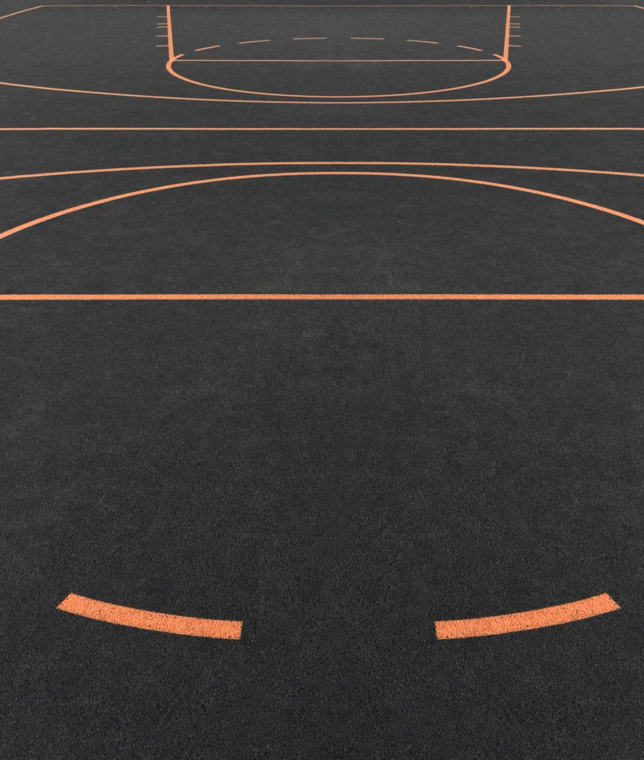
P.e.
CAMP at BF Adventure 16/17 September
We will be learning about:
Hockey
Leave vs. collect
Opposition, retrieve
Attack, defence
Tag Rugby
speed
dribbling
Vocabulary:
direction
opposition
control
collision
leave
position
collect

Slide 13
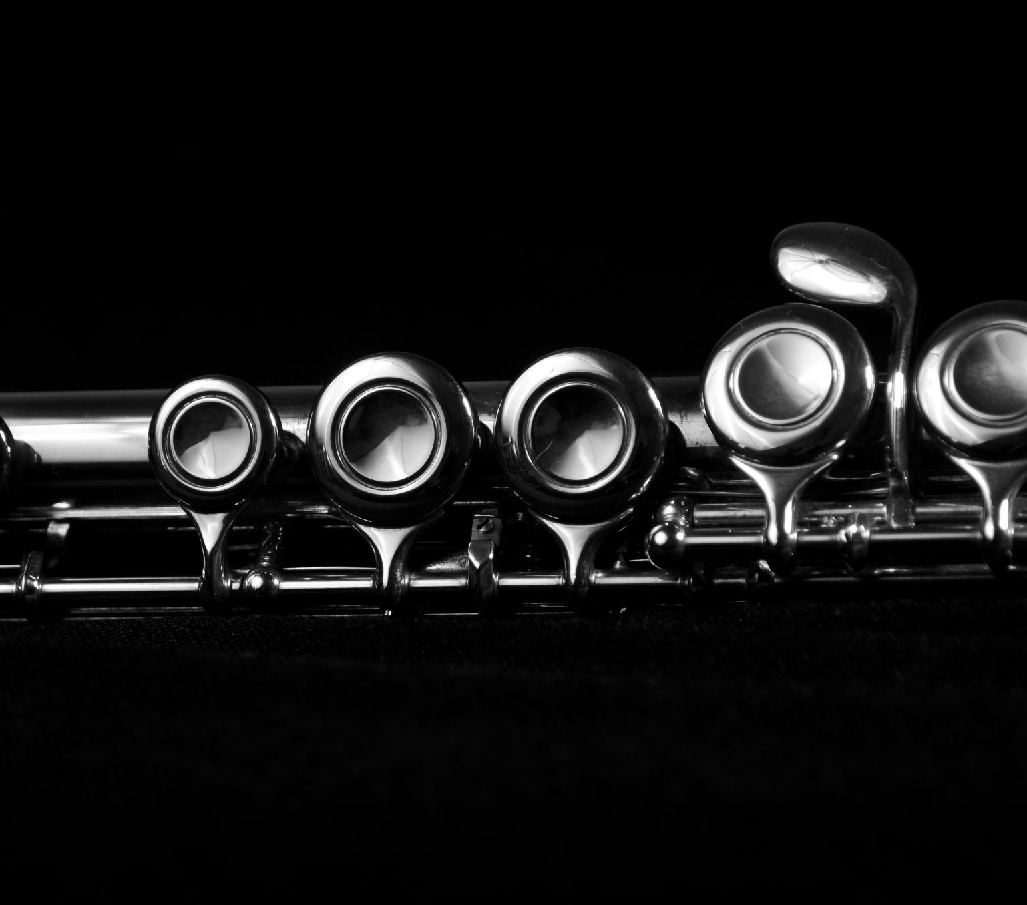
music
In our singing lessons on a Wednesday afternoon, we will be learning:
Improvise with voices on the notes of the pentatonic scale D-E-G-A-B (and B flat if you have one).
Sing in a Gospel style with expression and dynamics.
Sing Part 1 of a partner song rhythmically.
Play a bass part and rhythm ostinato along with This little light of mine.
Listen and move in time to songs in a Gospel style.
Also, about improvising and the texture of music we will learn: melody and accompaniment, unison, solo and ensemble.
pentatonic
staccato
Vocabulary:
call-and-respond
phase
echo
off-beat
articulation
legato

Slide 14
The Butterfly Lion, by Michael Morpurgo.
How does Gospel music make you feel? What instruments will you use to improvise ‘This Little Light of Mine’.
We will assess children’s learning using KIRFs and quizzes.
Learn about the rich tin deposits in Plateau States (the Holman Brothers of Camborne) Nigeria.
DT project .
We are going to design and build a vehicle for using on our imaginary “journey to Nigeria.” The vehicle will have axes and wheels and moving parts
Children will be

