Slide 1

The Early Years Foundation Stage EYFS
Kea Primary School
2022-2023

Slide 2

EYFS Curriculum Intent
At Kea Primary School we provide a high-quality, engaging and inspirational EYFS education giving children a secure and confident start to their school learning journey. We are committed to nurturing individuality, creativity and a lifelong love of learning alongside the aims of the EYFS statutory framework. We strive for high standards, valuing the development of the whole child and seek to foster resilient, articulate, free-thinking independent learners with a passion to succeed and reach their full potential.
We aim to provide the essential knowledge, skills, self discipline and confidence that children need to prepare them for their future success and to give children the best possible start to their early education.
We encourage pupil voice and want our children to articulate their personal beliefs, ideas, values and experiences.
We aim for them to gain an aptitude for dialogue, so that they can participate positively in our society with its diverse religions and beliefs.
We aim for our children to be respectful and knowledgeable of environmental issues and know the part they have to play in sustaining and looking after our planet.
We provide inviting classroom environments indoors and outdoors to stimulate learners and engage them in developing the three ‘Characteristics of Effective Learning’ as set out within the EYFS.
We have made informed choices about the experiences and content we want our curriculum to include and have carefully considered how the curriculum will build on prior learning. Our progression of skills document demonstrates how we intend to cover the skills and knowledge.
Staffing & Organisation
At Kea Primary School we have one Foundation class which caters for 30 children.
EYFS class teacher and lead: Mrs Harvey and Mrs Lawrence
EYFS class teaching assistant: Mrs Partridge, Mrs Whitford
Children come to our school mainly from our onsite pre school but also from other local pre-school settings and nurseries.
The EYFS curriculum encompasses our school motto…
“A great place to learn and make friends”
Believe, Achieve, Celebrate
We carefully plan our EYFS curriculum to meet the following aims:
Foster a love of learning which inspires curiosity.
Provide experiences of awe and wonder.
Ensure all children have access to high quality learning opportunities.
Provide parents/carers with the opportunity to develop their child’s learning at home.
Develop knowledge and understanding of the community and wider world.

Slide 3

Implementation
Impact
Quality first teaching across all areas of the curriculum.
Stimulating learning environments indoors and outdoors.
Well planned and organised continuous provision which allows the children to learn through play.
A carefully planned balance of adult-led and child-initiated learning opportunities.
We promote a love of learning through real life experiences and opportunities to build on prior learning.
Close links with local pre schools and nurseries which support a smooth and settled transition into school.
Strong parental partnerships which empower parents to support their child’s learning at home.
Systematic approaches to teaching reading to ensure all children learn to read. High quality phonics teaching is started as soon as children begin reception.
Opportunities for children and families to develop a love of reading.
Planned opportunities for outdoor learning.
High levels of engagement and motivation demonstrated from children which supports them to become lifelong learners.
Confident and capable readers who demonstrate a love of reading.
Evidence of strong links with parents.
Children demonstrate the characteristics of effective learning and are well prepared for the next stage in their learning.
Children feel happy and safe and enjoy coming to school.
All children access a balanced and challenging curriculum regardless of their background, needs or abilities.
Children make strong progress from their starting points and are offered a broad curriculum which meets each child’s unique needs.
Children are supported by adults that are well trained and passionate about providing the best education for every child.
The percentage of children achieving the GLD within the EYFSP is in line with or above the national average.

Slide 4

Learning in the EYFS
Play, Scaffolding, Modelling, Observing, Guided Learning, Direct Teaching
In our classroom, you may see children playing alone or with their peers, deciding on resources and choosing how to spend their time. You may see a child playing and listening to an adult, who is modelling how to achieve something or teaching a new skill that interests the child.
Adults may scaffold a child’s play. This involves taking their play to higher levels of learning, entering the play as a co-creator and helping to provoke a framework for the children to go from “what they know” to “what else they could know”. Scaffolding enables a child to solve a problem, carry out a task or achieve a goal which is just beyond his or her abilities. During play, where foundational social and emotional skills are developed, scaffolding is a bridge to new skill levels using three key ingredients; modelling the skill, giving clues and asking questions while the child is trying out a new skill, and then as the child approaches mastery, withdrawing the support.
The EYFS statutory framework does not prescribe a particular teaching approach.
“Play is essential for children’s development, building their confidence as they learn to explore, relate to others, set their own goals and solve problems. Children learn by leading their own play, and by taking part in play which is guided by adults.”
At Kea Primary School the EYFS leads carefully plan what the children learn in the classroom and through provision enables them to learn from their interests, alongside extending their knowledge and understanding through direct teaching.
Each day, we stimulate children’s interests, respond to each child’s emerging needs and guide their development through warm, positive interactions coupled with secure routines for play and learning.
As the children develop and their skills progress throughout the foundation year, we use more direct teaching and modelling and plan specific sequences of lessons. These strategies help us to focus on teaching the essential skills and knowledge in the specific areas of learning so that the children can develop the skills and confidence required for the end of their foundation year.

Slide 5
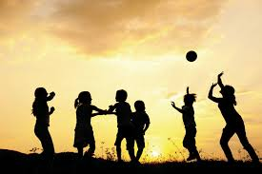
Seven Key Features of Effective Practice
The best for every child
High-quality care
At Kea Primary School children will be given an equal chance of success.
We ensure that all children have access to high-quality early education. We identify children from disadvantaged backgrounds to ensure we can ‘narrow the gap’.
We provide high-quality early education and care which is inclusive for all children. Children’s special educational needs and disabilities (SEND) are identified quickly. All children promptly receive any extra help they need, so they can progress well in their learning.
Our practitioners ensure the children’s experience is the central focus of thinking.
We ensure our young children are well cared for to enable them to thrive.
High-quality care is consistent. All practitioners enjoy spending time with young children and this is reflected in their interactions with children.
Practitioners are responsive to children and ensure they form effective and positive relationships with all children.
Practitioners support children to develop their independence.

Slide 6

Seven Key Features of Effective Practice
The curriculum
Pedagogy
The curriculum is well planned to ensure we identify ‘what we want’ the children at Kea Primary School to learn.
We ensure planning helps every child to develop their language skills.
The curriculum is ambitious. Careful sequencing will help children to build their learning over time.
Planning is flexible to ensure children’s interests are used to drive the children’s learning and development.
We ensure that depth in early learning is achieved through spending time embedding the children’s learning.
Every child is enabled to make progress in their learning, with the right help.
We utilise different approaches to learning to ensure all children make progress. Children learn through play, by adults modelling, by observing each other, and through guided learning and direct teaching.
Practitioners carefully organise enabling environments for high-quality play.
Children in our early years also learn through group work, when practitioners guide their learning.
As the children develop throughout the year they are given more guided learning.
We have a well-planned learning environment, indoors and outdoors.

Slide 7

Seven Key Features of Effective Practice
Assessment
Self-regulation
Assessments are completed to inform planning and support the practitioners in identifying children who need additional support.
Assessment is based upon a secure knowledge of child development.
Practitioners have a clear expectation about what children need to know and how best to support them in developing their learning.
Accurate assessment is used to highlight whether a child has a special educational need or needs extra help.
Tapestry is used to record an electronic learning journey for each child. Tapestry is used as a valuable tool to assess children’s development and to provide a link for parents/carers.
As part of our ‘Personal, Social, Emotional Development’ teaching provision we support each child’s ability to:
hold information in mind
focus their attention
think flexibly
inhibit impulsive behaviour.
These abilities contribute to the child’s growing ability to self-regulate:
concentrate their thinking
plan what to do next
monitor what they are doing and adapt
regulate strong feelings
be patient for what they want
bounce back when things get difficult.

Slide 8

Seven Key Features of Effective Practice
Partnership with parents
We ensure that parents/carers have a strong and respectful partnership in the early years which enables children to thrive.
We listen regularly to parents and give parents clear information about their children’s progress through face to face opportunities and electronically via Tapestry.
Parents are encouraged to support their child’s learning and development at home as this has a significant impact on their child’s learning.
We take the time to ‘get to know’ and understand the children and their families enabling us to offer support as needed.
Parents/carers are invited into school for ‘Stay and Play’ session’s with their child prior to starting school. This provides parents/carers with the opportunity to familiarise themselves with the classroom environment and meet other parents.
Parents/carers are given the opportunity throughout the year to engage in the wider school community.
Parents/carers are fully involved in their child’s learning and development through the use of Tapestry, which is regularly updated.
Parent’s are invited into school for regular parents evenings to provide an update about their child’s learning and progress.
Children with SEND or additional needs have in-depth ‘shared conversations’ to ensure targets and progress are shared.
We are flexible in our approach to communicating with parents/carers and adapt our communication methods to suit different preferences.

Slide 9

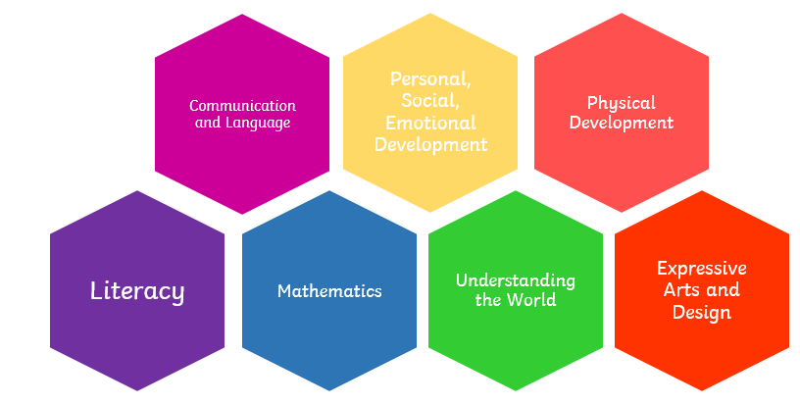
EYFS Statutory Framework
Characteristics of Effective Learning describe behaviours children use in order to learn. To learn well, children must approach opportunities with curiosity, energy and enthusiasm. Effective learning must be meaningful to a child, so that they are able to use what they have learned and apply it in new situations. These abilities and attitudes of strong learners will support them to learn well and make good progress in all the Areas of Learning and Development.
The three characteristics of effective teaching and learning are:
• Playing and exploring – children investigate and experience things, and ‘have a go’.
• Active learning – children concentrate and keep on trying if they encounter difficulties, and enjoy achievements.
• Creating and thinking critically – children have and develop their own ideas, make links between ideas, and develop strategies for doing things.
Areas of Learning and Development
Prime areas of development and learning lay vital foundations in the early years. The three prime areas are: CL, PSED and PD. The four specific areas are: L, M, UW, EAD which build on the development gained through the prime areas.

Slide 10
When we give every child the best start in their early years, we give them what they need today. We also set them up with every chance of success tomorrow.
Development Matters [DfE, 2021]

