Slide 1
What happened to the ancient kingdom of Benin? Spring 2

Slide 2
reading
We will continue to cover the discrete reading skills
Vocabulary and infer Predict and explain Retrieve and summarise Class read: Children of the Benin Kingdom by Dinah Orji

Slide 3
writing
The text types we are learning about this half term is a persuasive text through a travel brochure.
Independent Writing - Using the ‘Independent Writing Teaching Sequence’ included, teachers move through the steps to guide children from the highly modelled Sentence Stack to writing independently. When writing persuasive texts, the pupil’s independent task should be to craft their own text. This gives pupils real freedom to develop their content around a theme independently.

Slide 4
maths
We will be learning about Fractions and Decimals
Step 1 Understand the whole Step 2 Count beyond 1 Step 3 Partition a mixed number Step 4 Number lines with mixed numbers Step 5 Compare and order mixed numbers Step 6 Understand improper fractions Step 7 Convert mixed numbers to improper fractions Step 8 Convert improper fractions to mixed numbers Step 9 Equivalent fractions on a number line Step 10 Equivalent fraction families Step 11 Add two or more fractions Step 12 Add fractions and mixed numbers Step 13 Subtract two fractions Step 14 Subtract from whole amounts Step 15 Subtract from mixed numbers

Slide 5
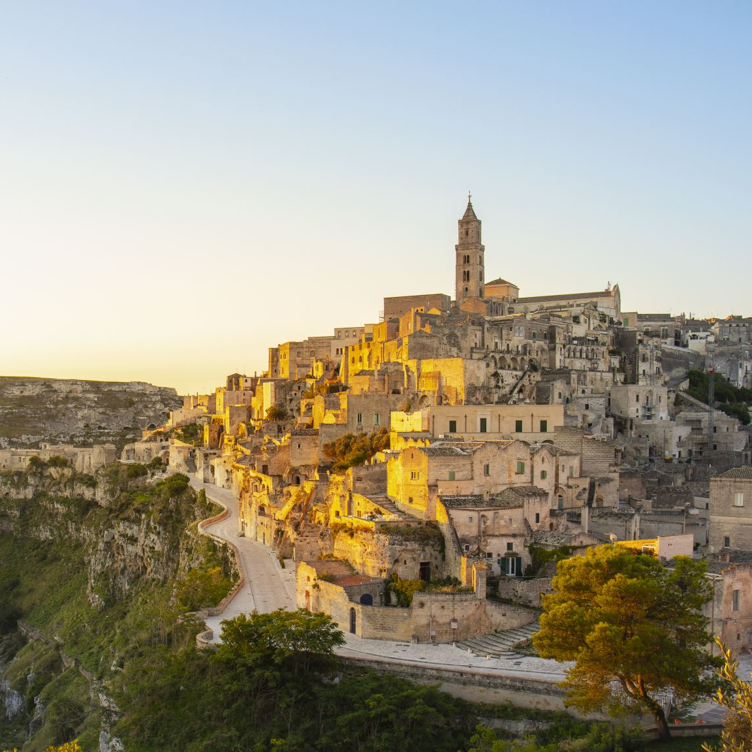
History
We will be learning about The Ancient Kingdom of Benin
I can identify the geographical location of the Kingdom of Benin and explain its significance in West African history. I can explore the art and cultural practices of the Kingdom of Benin, I can learn about the trade networks of the Kingdom of Benin I can describe the political organisation of the Kingdom of Benin, including the roles of the Oba, councillors, and other officials, and how this structure contributed to the kingdom's stability and governance I can examine the interactions between the Kingdom of Benin and European powers I can reflect on the legacy of the Kingdom of Benin in contemporary society
The Kingdom of Benin was established around AD 900 in West Africa, in modern-day Nigeria.
The Edo people who settled in Benin were ruled over by a powerful leader, called the Oba, from the 1100s.
In 1897, British rulers sent an army of 1000 soldiers to invade Benin City.
The first dynasty of Benin was ruled over by leaders called Ogisos, which means rulers of the sky.

Slide 6
Computing
We will be learning about Data and Information – Data logging
I can explain that data gathered over time can be used to answer questions. I can use a digital device to collect data automatically. I can explain that a data logger collects ‘data points’ from sensors over time. I can recognise how a computer can help us analyse data. I can identify the data needed to answer questions. I can use data from sensors to answer questions

Slide 7
pshe
We will be learning about Living in the wider world - Aiming High
I can identify achievements and suggest how my actions can help me to achieve. I can identify personal goals and suggest actions that I can take to achieve them. I can explain how a positive learning attitude can help me to learn new things. I can identify the skills and attributes needed to do certain jobs. I understand that we should all have equal opportunities to follow our career ambitions. I can discuss what job I might like to do when I grow up and what skills I will need to achieve this
dial 999 for emergency help.
The first line of my address and town is …
My date of birth is...
Childline telephone is 0800 1111.
Two ways to keep safe online are to never share personal information and always tell a trusted adult when something scares me.
The difference between banter/joking and bullying is that the victim enjoys banter, bullying is upsetting and repeated.

Slide 8
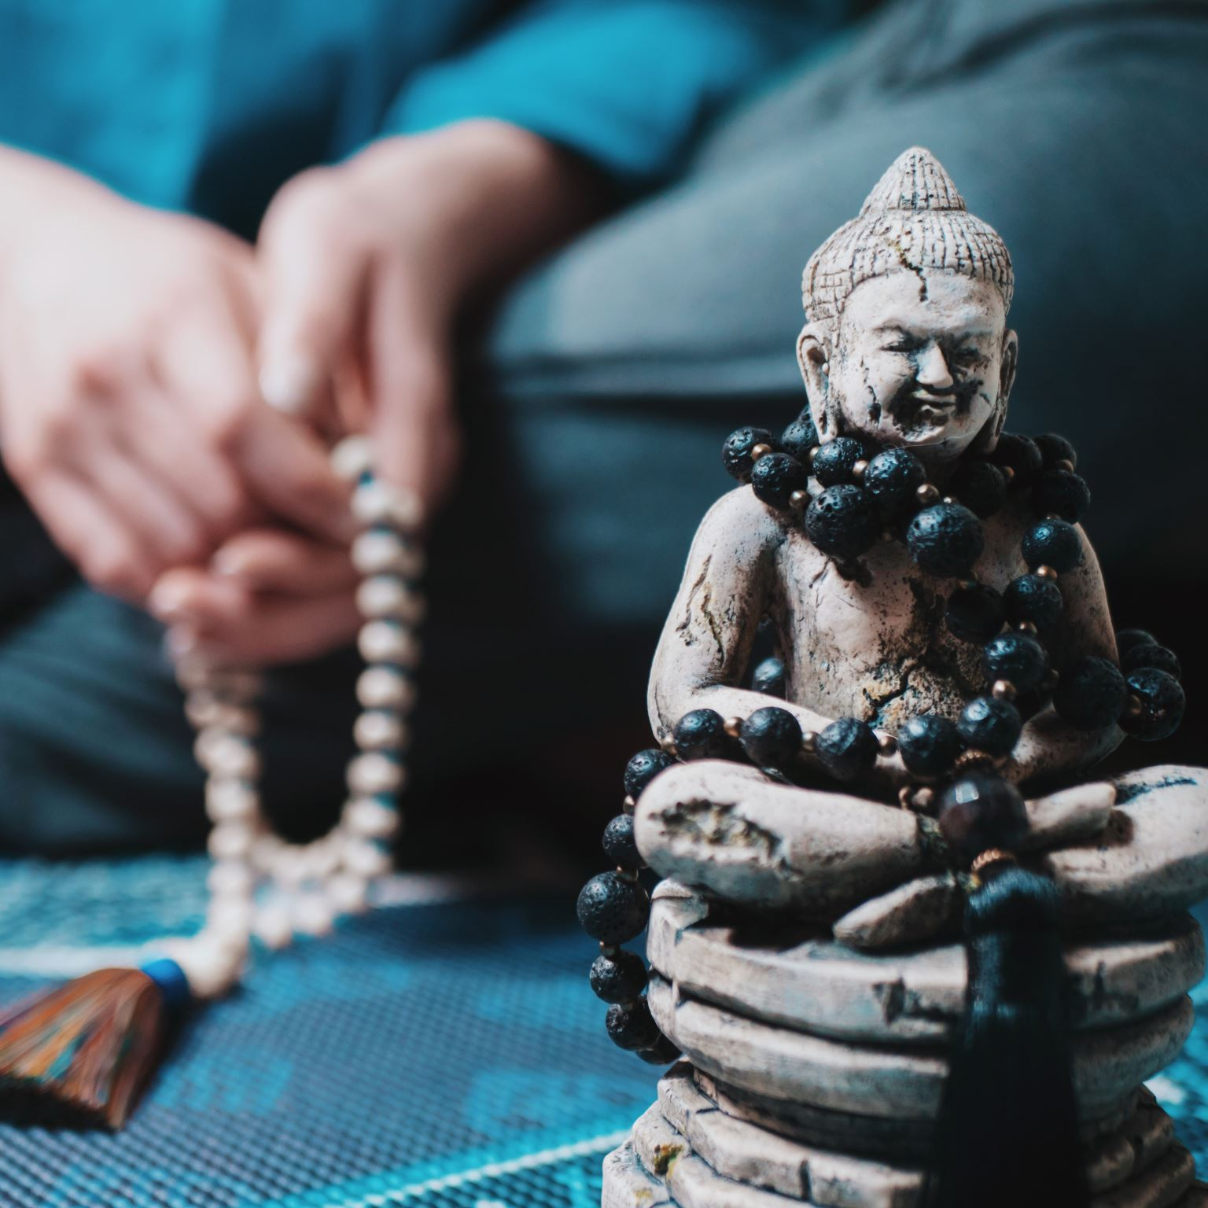
RE
We will be learning about What do Hindus believe God is like?
I can describe the Hindu belief in Brahman as the Supreme Being I can recognise and name the three principal gods in Hinduism I can learn about the many forms and avatars of God in Hinduism I can explore how Hindus worship different deities through rituals and prayer I can understand the Hindu belief that God is not separate from the natural world and recognize the sacredness of animals, rivers, and other elements of nature in Hinduism. I can compare the Hindu belief in multiple forms of God to beliefs in other major religions
Hinduism is over 4,000 years old, making it one of the world's oldest religions.
It originated near the Indus River in India.
Central to Hinduism is the belief in a supreme God Brahman. Brahman is present everywhere and there is a part of Brahman in everyone.
Hindus worship in a temple called a Mandir.

Slide 9
French
We will be learning about …..
In this unit, pupils will learn how to: I can attempt to name up to 5 animals in French with their correct article/determiner but will need to look at the vocabulary sheet first if/when attempting the spellings. I am beginning to learn that articles/determiners work differently in French than they do in English and that I will have to always learn the article/determiner alongside the noun. I can say/write a short phrase using the verb ‘je suis’ (I am) and an animal in French but may need to look at the vocabulary sheet first to support with the spellings.

Slide 10
pe
We will be learning Orienteering and Gymnastics
To work cooperatively as part of a team. To understand different points on a map. To communicate effectively with others. To make a map. To participate in team games solving problems with others. To take part in an orienteering event.
To perform 9 key shapes. To create sequences of movements, shapes, balances, and rolls. To travel using different body parts. To work with others mirroring and cannoning. To travel on different levels at different speeds. To perform in front of others.

Slide 11
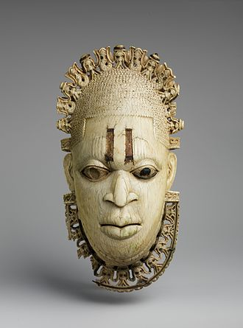
ART
We will be creating a 3D clay mask in the style of the Edo ethnic group of Benin .
Children will be able to: Drawing Create a paper template of a final design Use combinations of line and pattern to create a design Annotate studies with likes, styles, materials Clay mask Roll out a consistent thickness of clay Use large tools to create a curved shape Select tools to cut and shape a material as desired Create extra features from separate pieces of clay Add features to the main art piece using slip Persevere when work becomes challenging

Slide 12
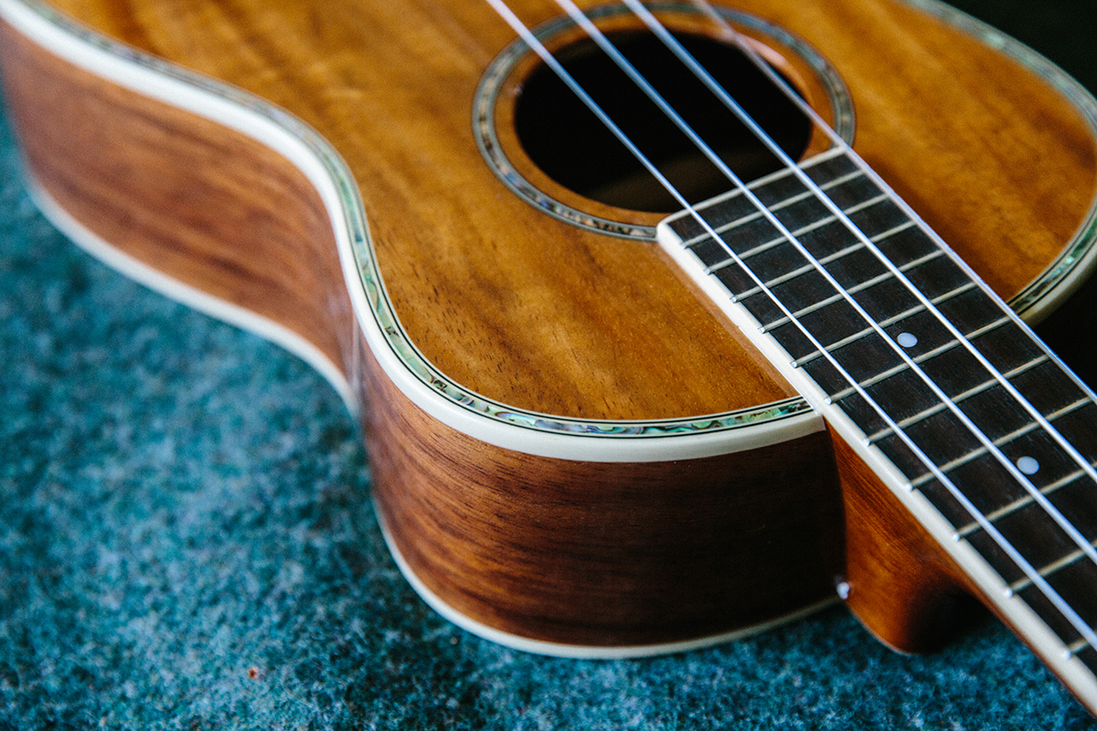
music
We will be learning about during the unit, pupils will learn to sing and play the song, develop technical skills on tuned percussion, and experience playing in a class band.
Playing and singing activity is supported by listening to range of music in a folk and folk-rock style, comparing different artists’ styles. Lesson 1: Get to know the song – Learn Verse 1, learn the verse chords. Lesson 2: Get to know the song – Learn the Chorus, learn the Chorus chords. Lesson 3: Progression snapshot 2. Make a video recording of children singing. Lesson 4: Recap playing Verse 1 and the Chorus and compare pieces of music. Lesson 5: Practise singing and playing the song. Lesson 6: Rehearse and perform.

Slide 13
This half term will be reading Children of the Benin Kingdom by Dinah Orji.
Our Udeskole sessions will focus on Orienteering
We are planning an educational visit for this half term to the Seal Sanctuary for a workshop on pollution.
We will have a visit from our local from Kea Church for our Easter Workshops.
In History our Kea task to assess pupil’s learning will be to create a poster showing their understanding of the Kingdom of Benin
Our RE topic studying how other religions choose to live their lives
We will explore Benin cuisine with Moyo de Poulet Fume (Smoked Chicken with Sauce)
In science we will have a new investigation next term.
We will think about how ocean pollution is affecting the planet on our school trip
We will listen to west African styled songs whilst we work independently.

