Slide 1
Maths Challenges NRICH 3 star

Slide 4
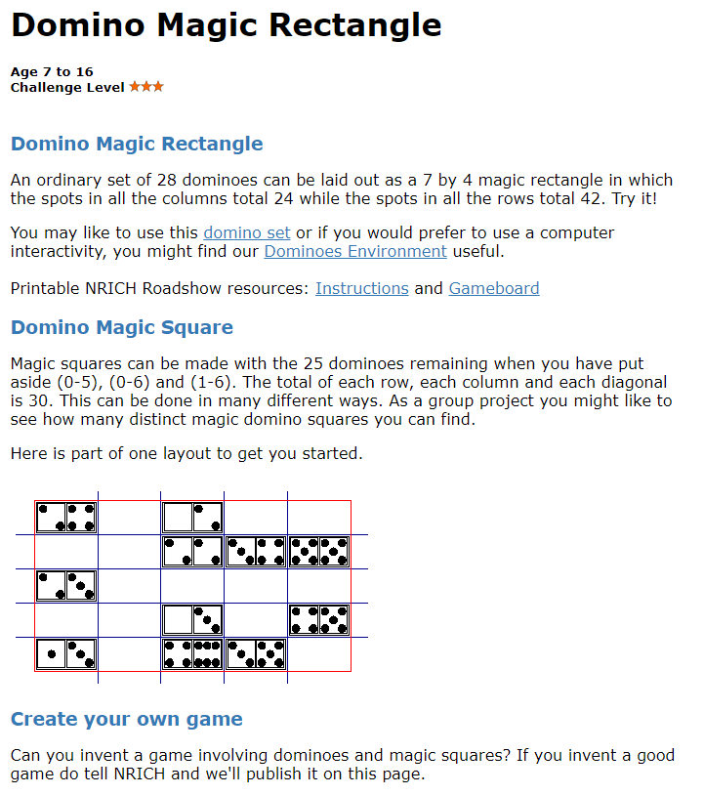

Slide 6
